Slide 1

Programming Trends
Analysis of programming data from FY21 through FY25, as reported through RI Public Library Annual Survey

Slide 2
Library Programming Overall Summary
Rhode Island libraries are close to achieving a return to pre-pandemic program numbers.
During FY 2019, RI public libraries offered 35,649 programs, with recorded attendance of 556,915.
During FY 2025, RI public libraries offered 31,265 programs, with recorded attendance of 478,662.

Slide 3
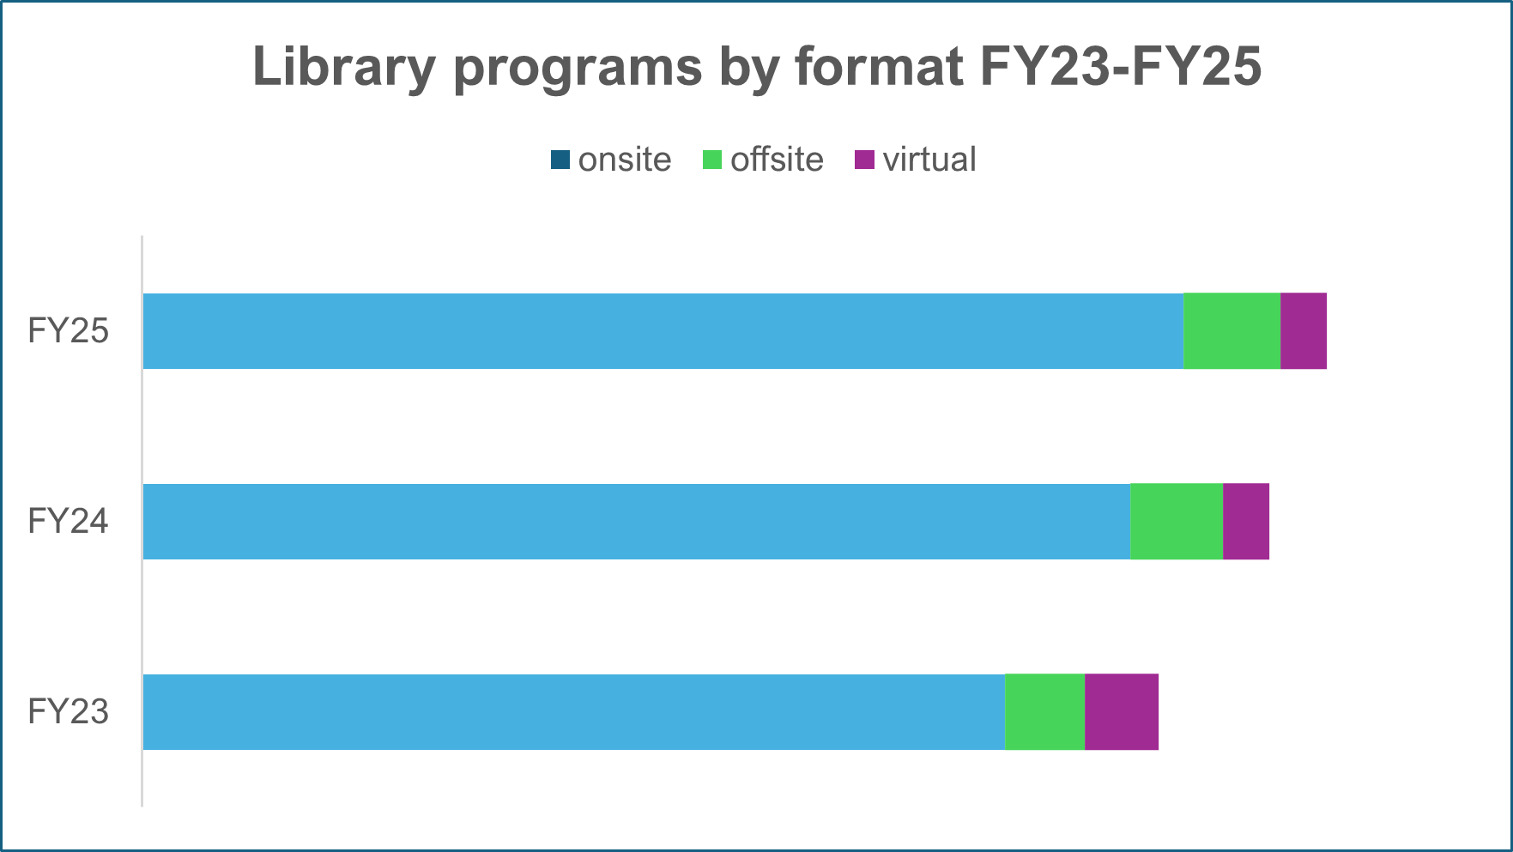
Library Program Sessions by Format
Onsite and offsite program sessions continue to grow post-pandemic.

Slide 4
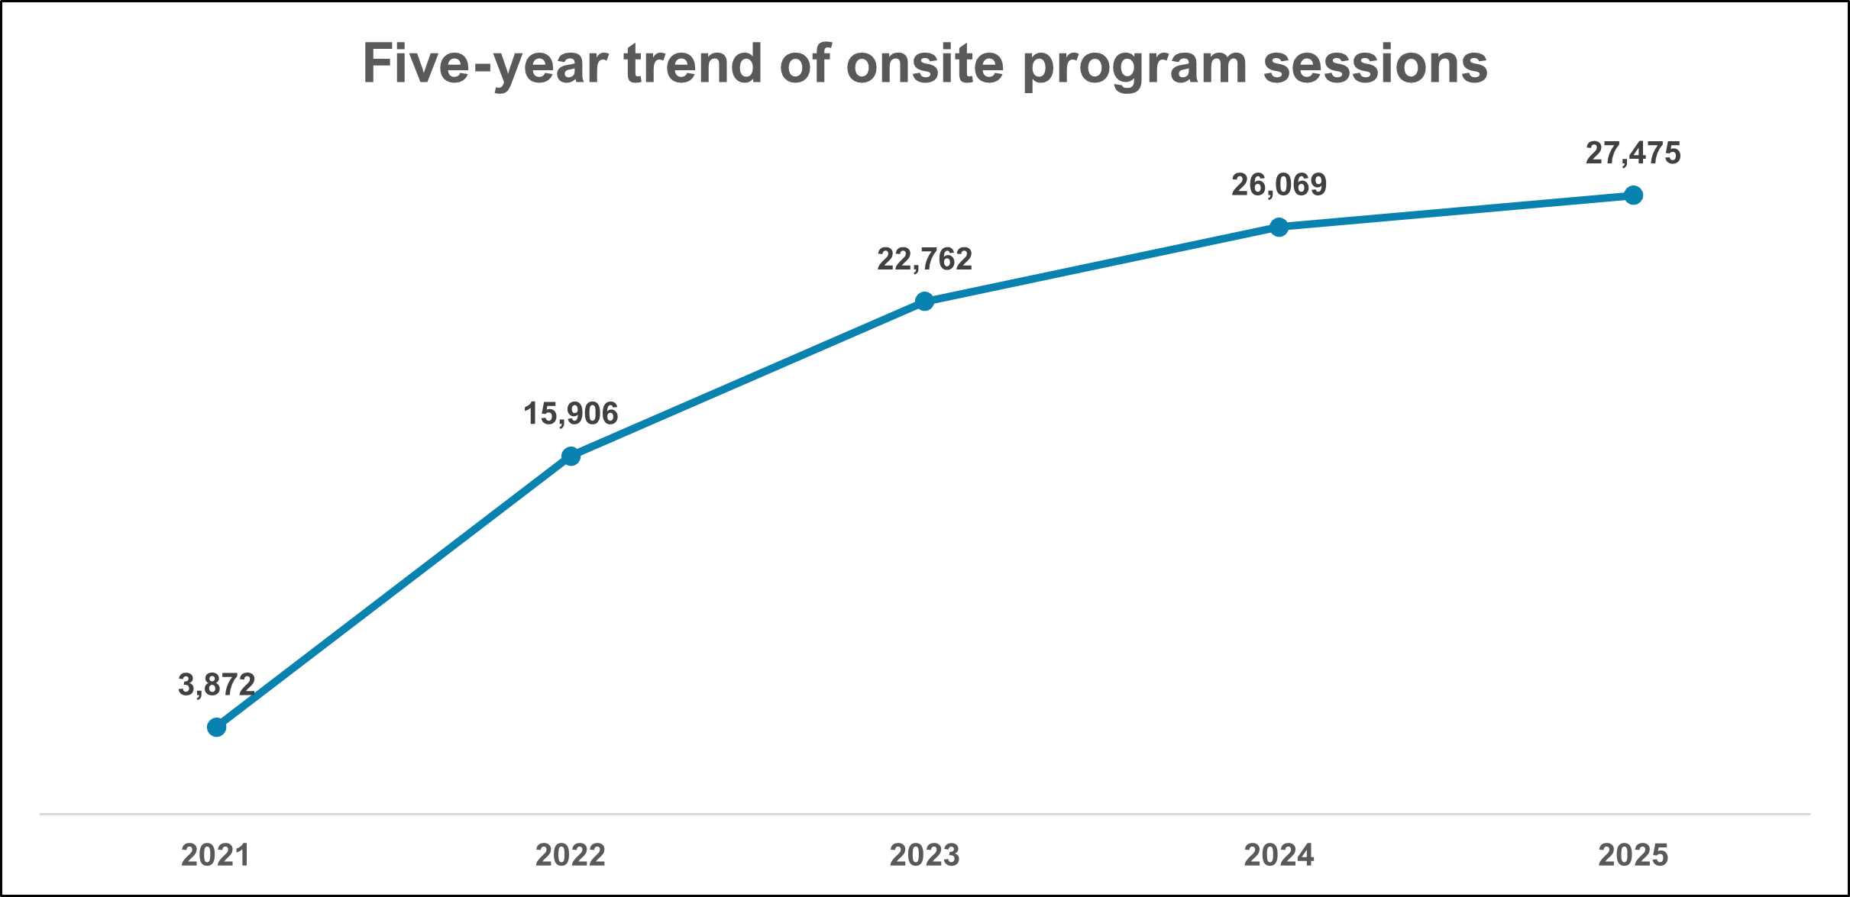
Onsite Program Sessions
20% increase from FY 2023 to FY 2025 for onsite program sessions.
Onsite program sessions made up 88% of programming in FY 2025.
Top 3 audiences for onsite programs
Adult (19 years and older)
Preschool (0-5 years old)
School age (6-11 years old)

Slide 5
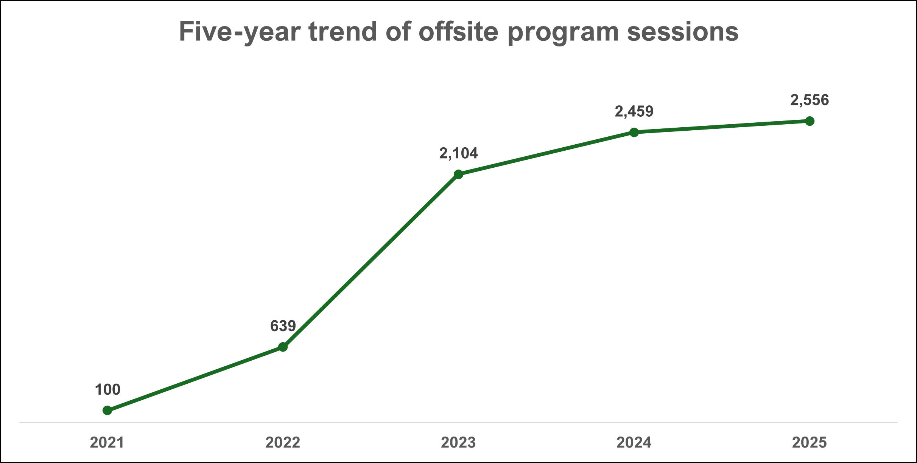
Offsite Program Sessions
21% increase from FY 2023 to FY 2025 for offsite program sessions.
Offsite program sessions made up 8% of total programming in FY 2025.
Top 3 audiences for offsite programs
Adult (19 years and older)
Preschool (0-5 years old)
Elderly

Slide 6
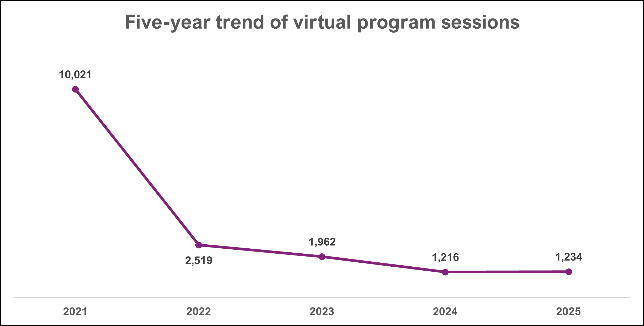
Virtual Program Sessions
Virtual program sessions plummeted after FY 2021 but have stabilized the past two fiscal years.
Virtual program sessions made up 4% of total programming in FY 2025.
Top audiences for virtual programs
Adult (19 years and older)
Young Adult (12-18 years old)
Statewide, 4 or fewer virtual programs offered for other audiences in FY 2025.

Slide 7
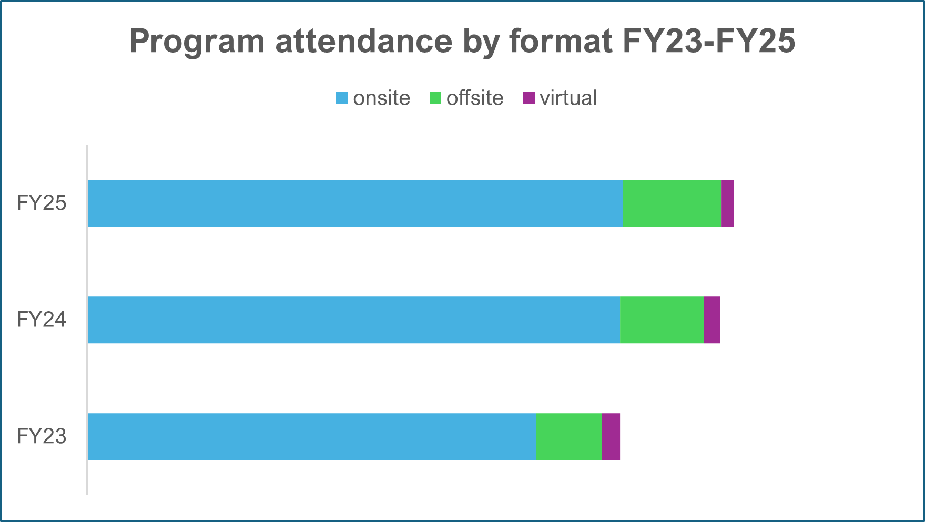
Library Program Attendance by Format
51% increase in offsite program attendance from FY 2023 to FY 2025.

Slide 8
Audience Trends
Reporting program sessions and attendance by audience, then by format, began in FY 2023.

Slide 9
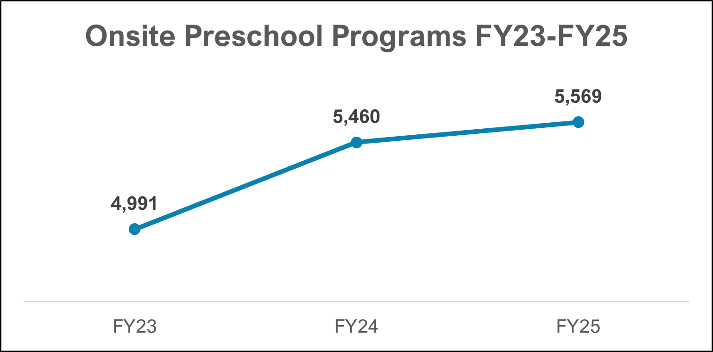
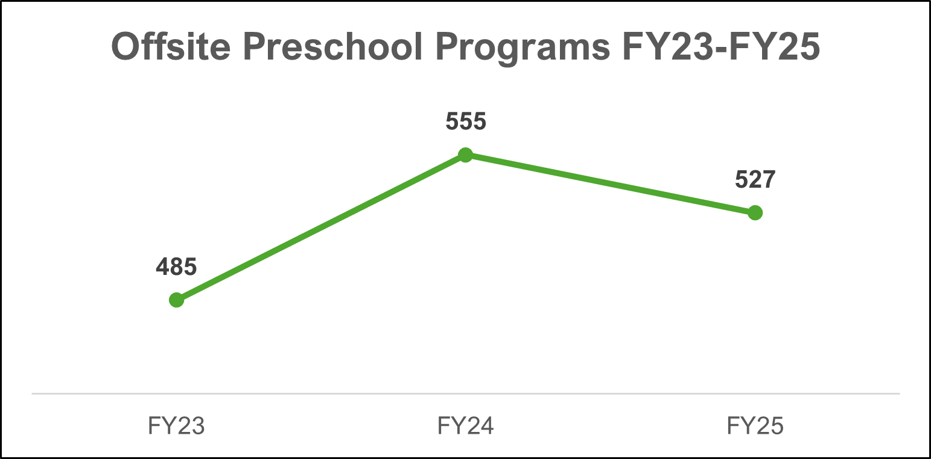
Preschool Program Sessions
Overall 11% increase from FY 2023 to FY 2025, primarily through onsite programs.
Some libraries are now reporting programs for this audience as Family programs, which may have impacted trend data.

Slide 10
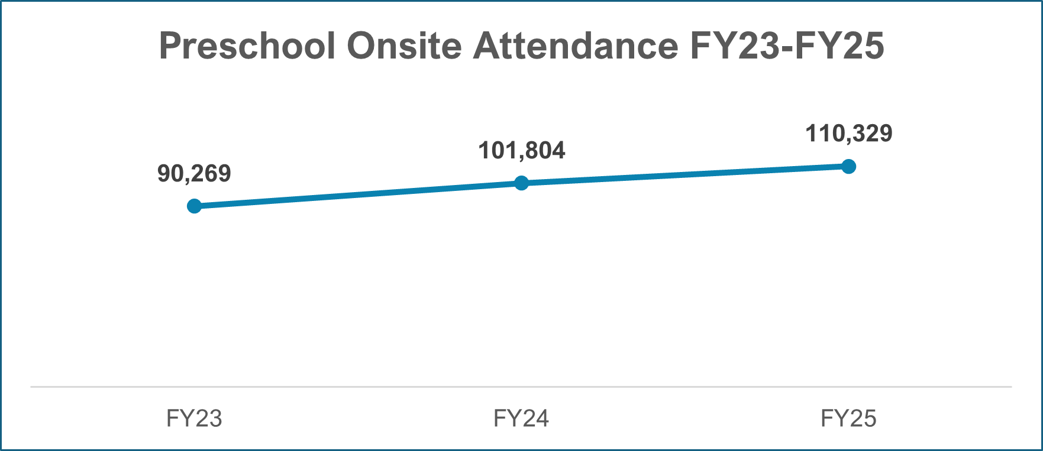
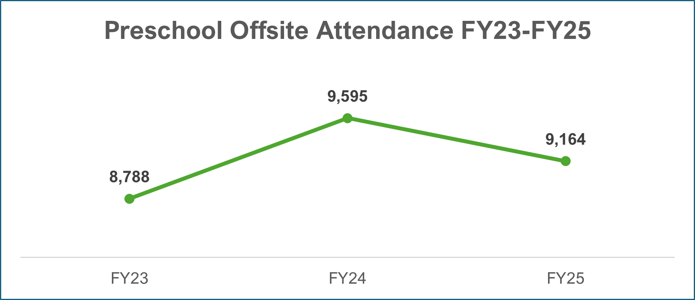
Preschool Program Attendance
Preschool onsite attendance increased an average of 10,000 attendees each year from FY 2023 to FY 2025.
Preschool has the highest number of onsite attendees of any audience.

Slide 11
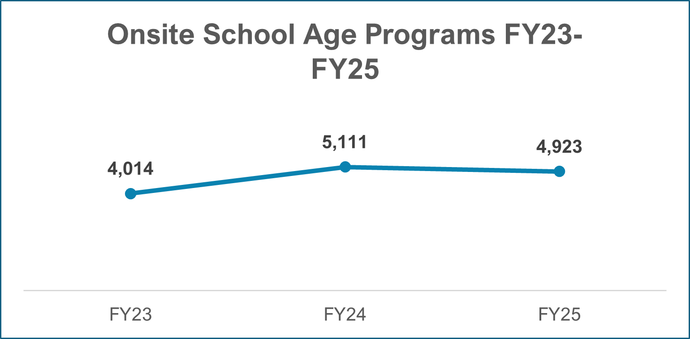
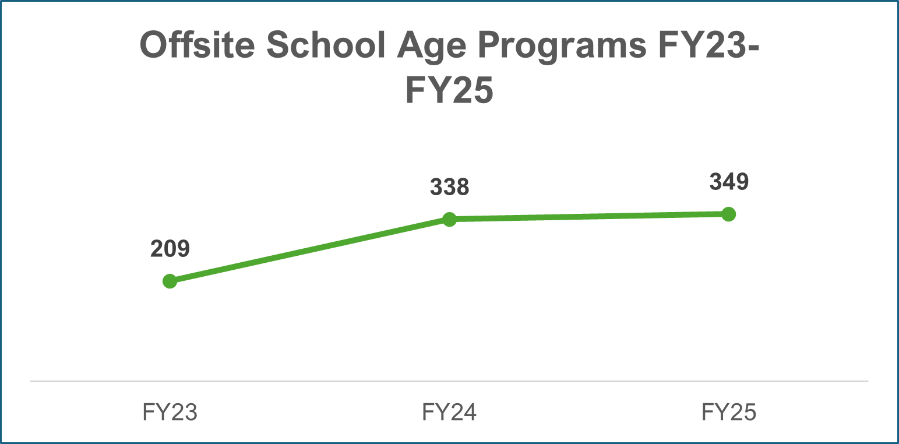
School Age Program Sessions
Overall 21% increase from FY 2023 to FY 2025.
Offsite program sessions shows slight increase from FY24 to FY25.

Slide 12
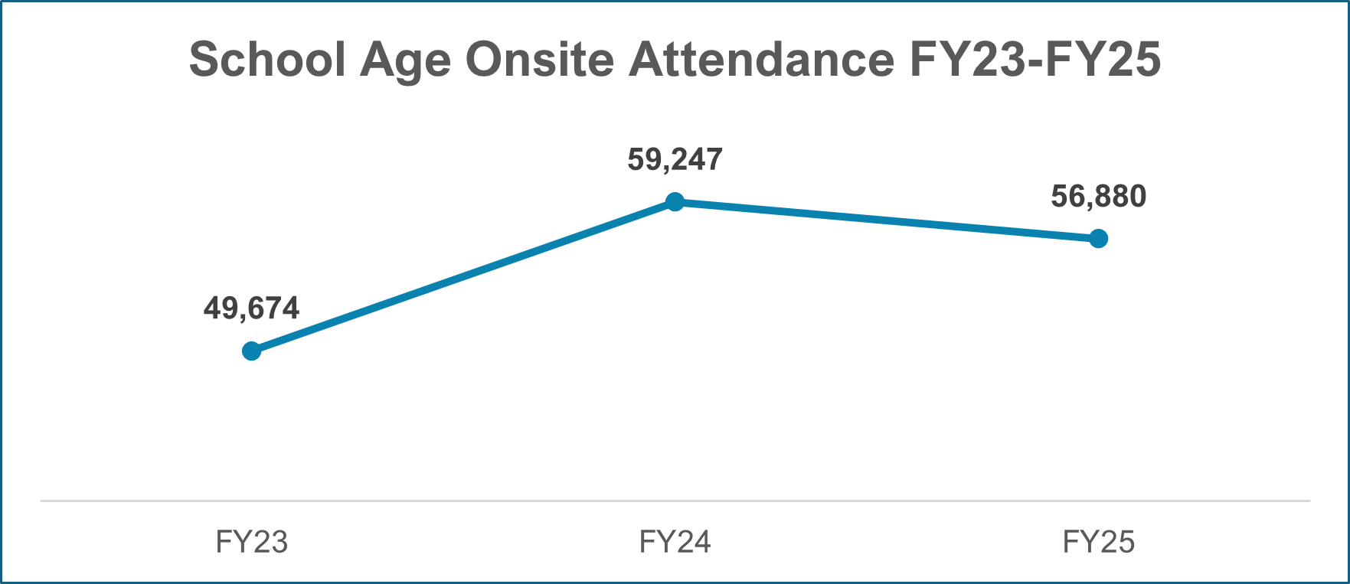
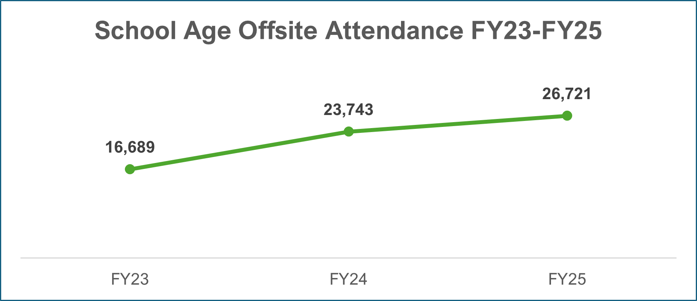
School Age Program Attendance
School age audience had the highest number of offsite program attendance in FY 2025.
Offsite program attendance shows consistent growth year over year.

Slide 13
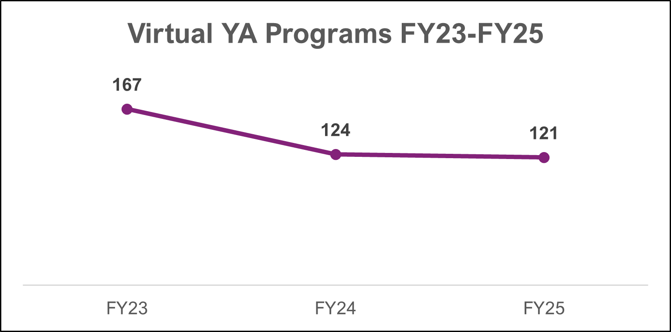
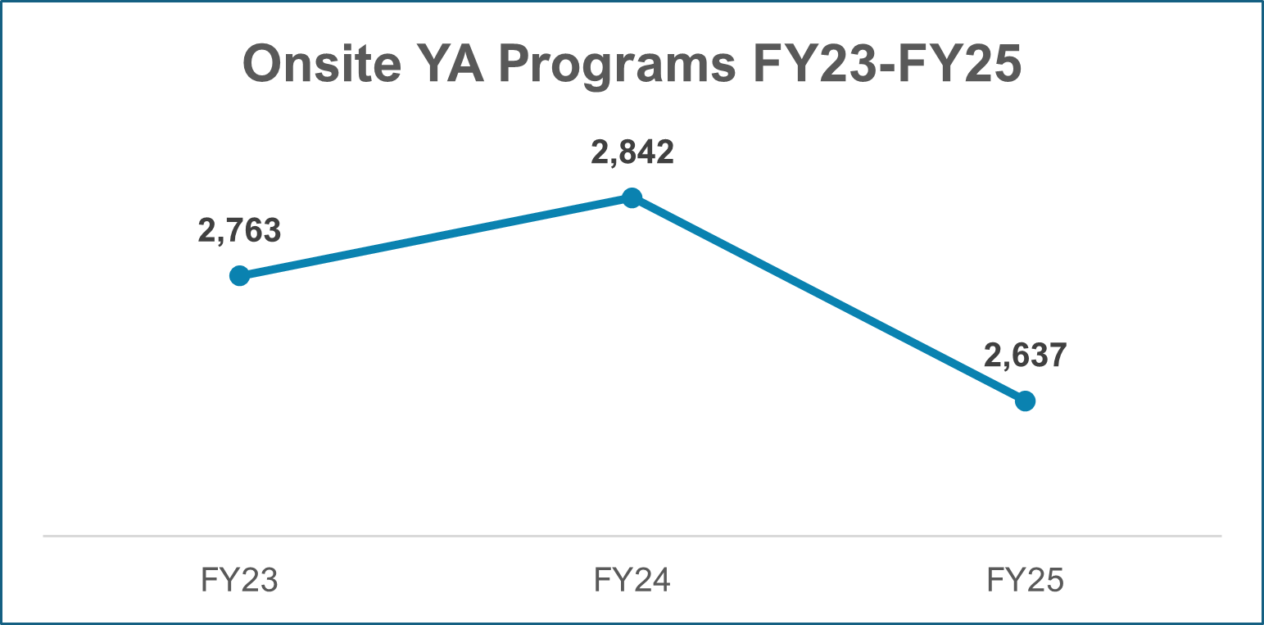
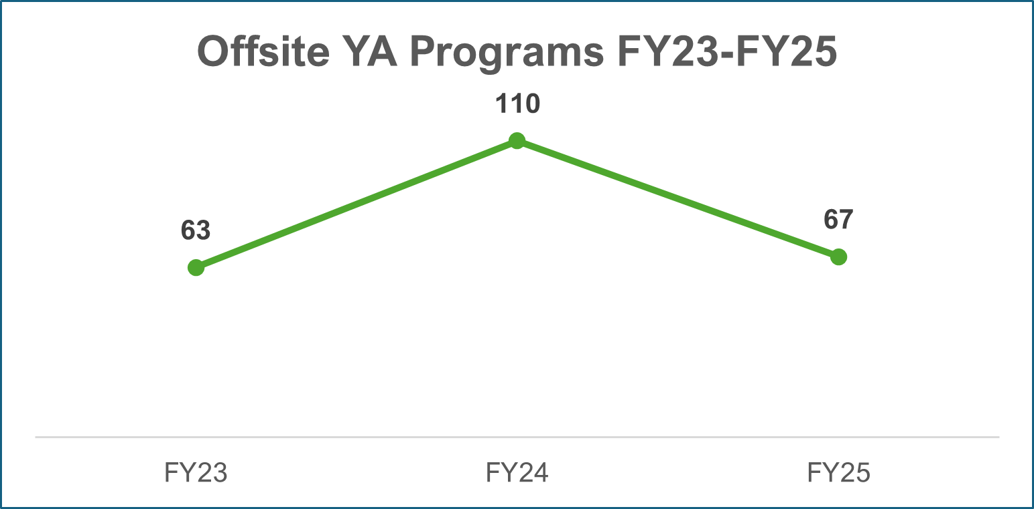
Young Adult Program Sessions
Overall 5% decrease from FY 2023 to FY 2025.
Virtual program offerings overall steady for YA audiences.

Slide 14
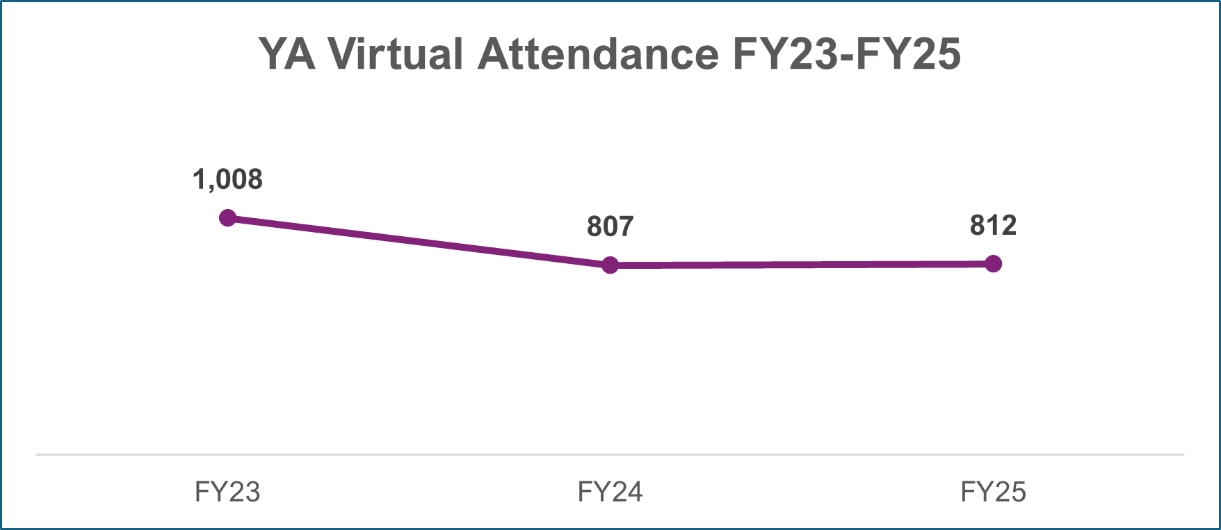
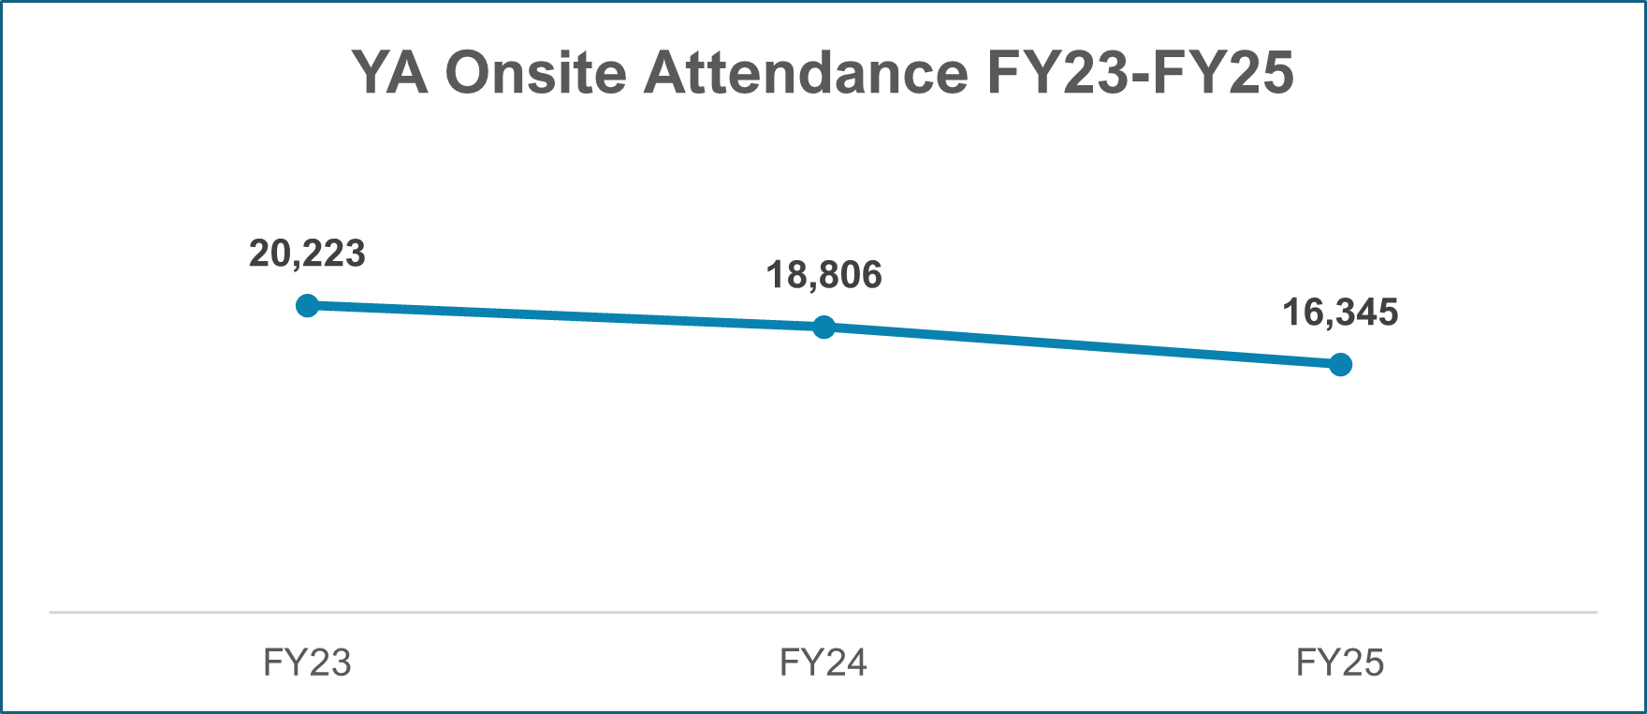
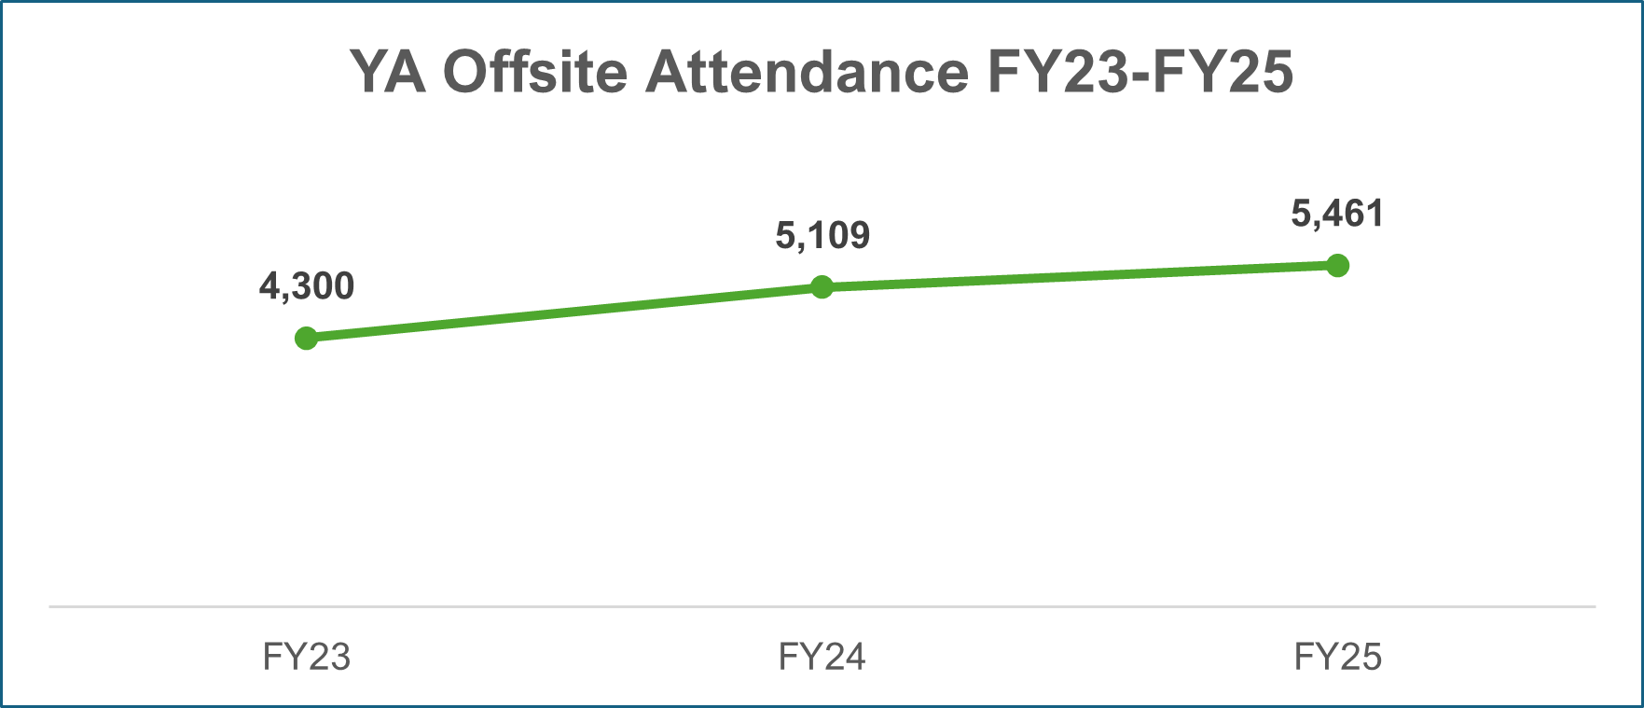
Young Adult Program Attendance
7% increase in offsite program attendance between
FY 2024 to FY 2025.
Despite decrease in number of YA offsite programs, attendance continues to grow modestly.
YA virtual program attendance steady at around 800 for FY24 and FY25.

Slide 15
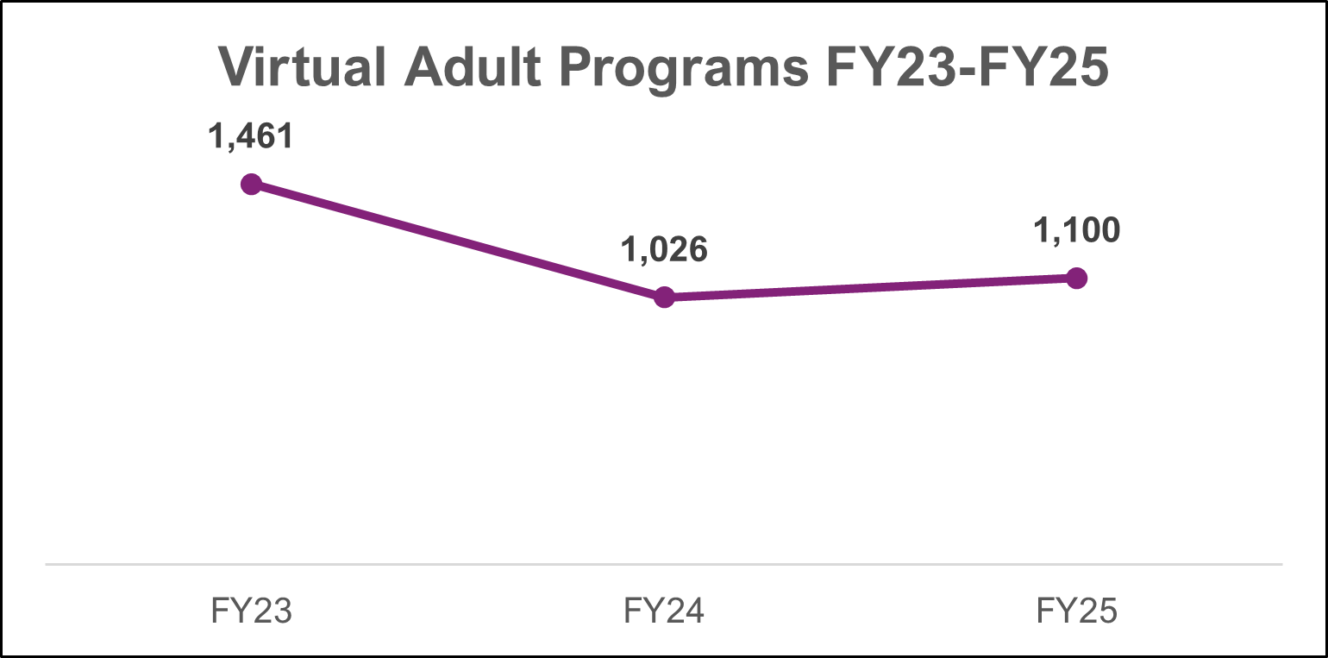
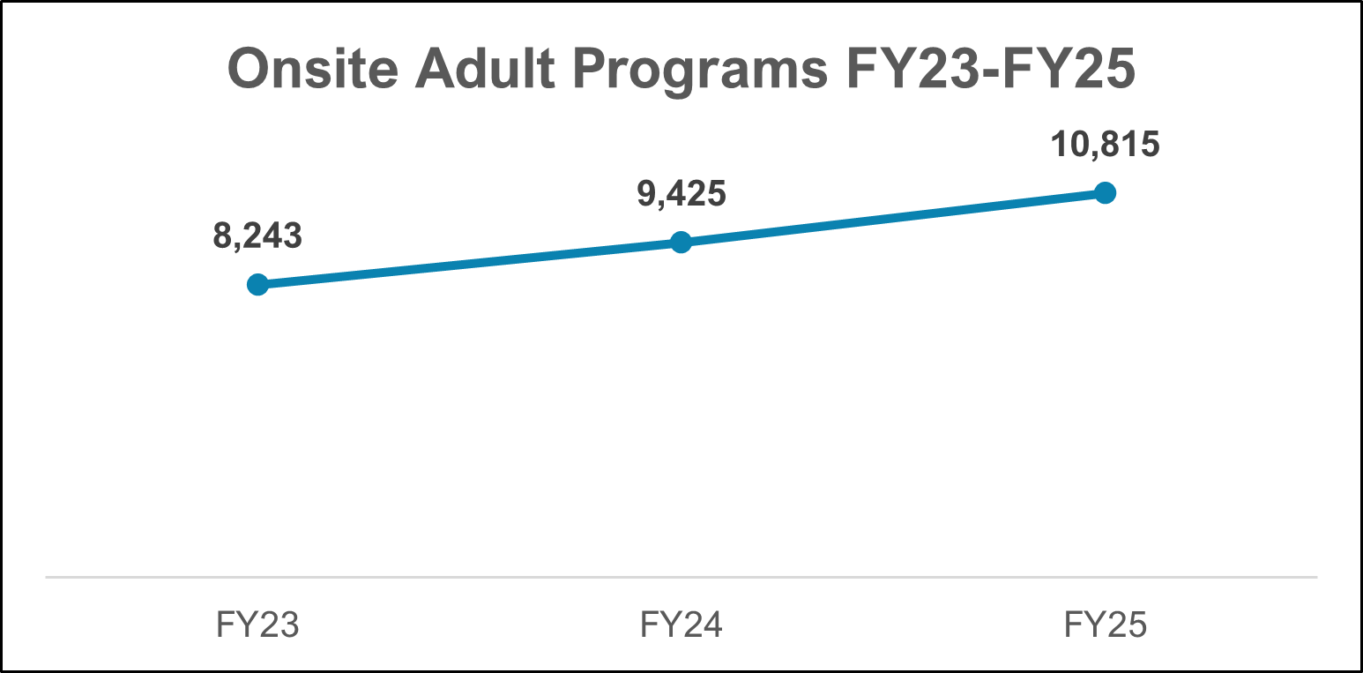
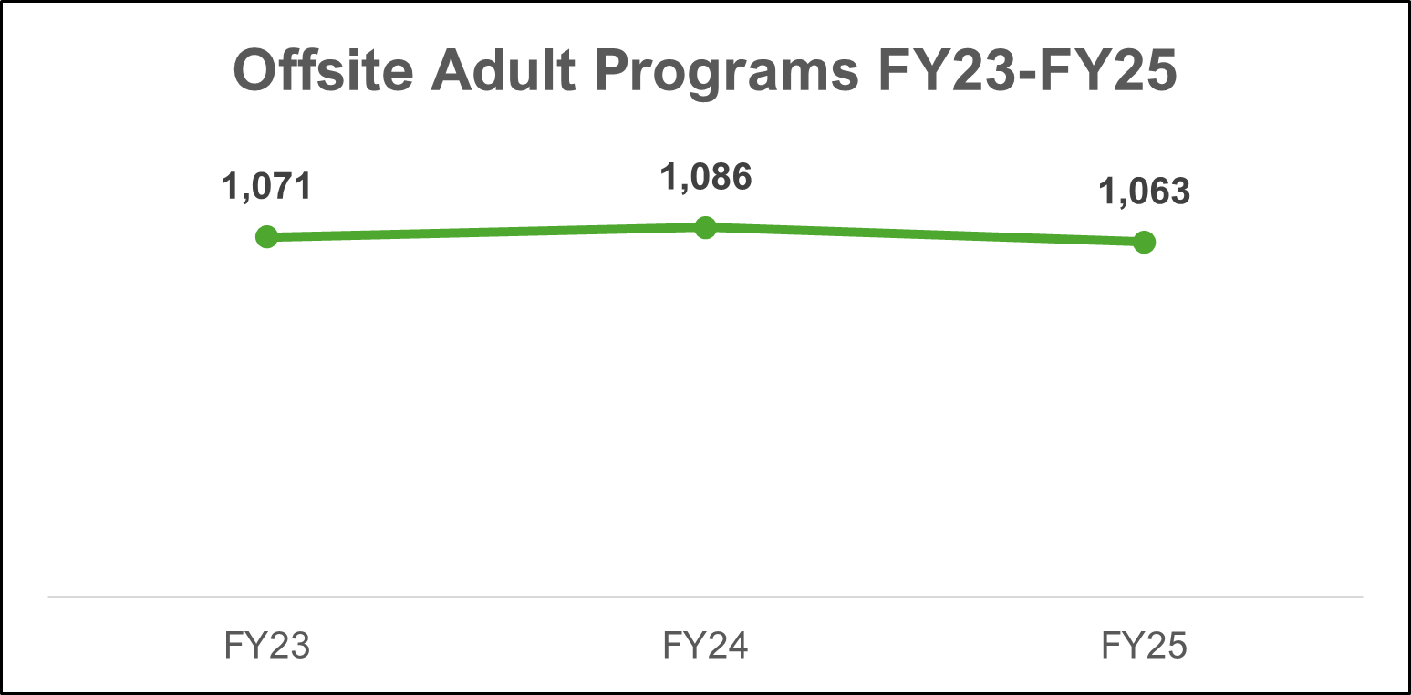
Adult Program Sessions
Overall 20% increase from FY 2023 to FY 2025.
Overall increase mostly due to onsite programs.
25% decrease in virtual programs offered between FY23 and FY24, but slight increase from FY24 to FY25.

Slide 16
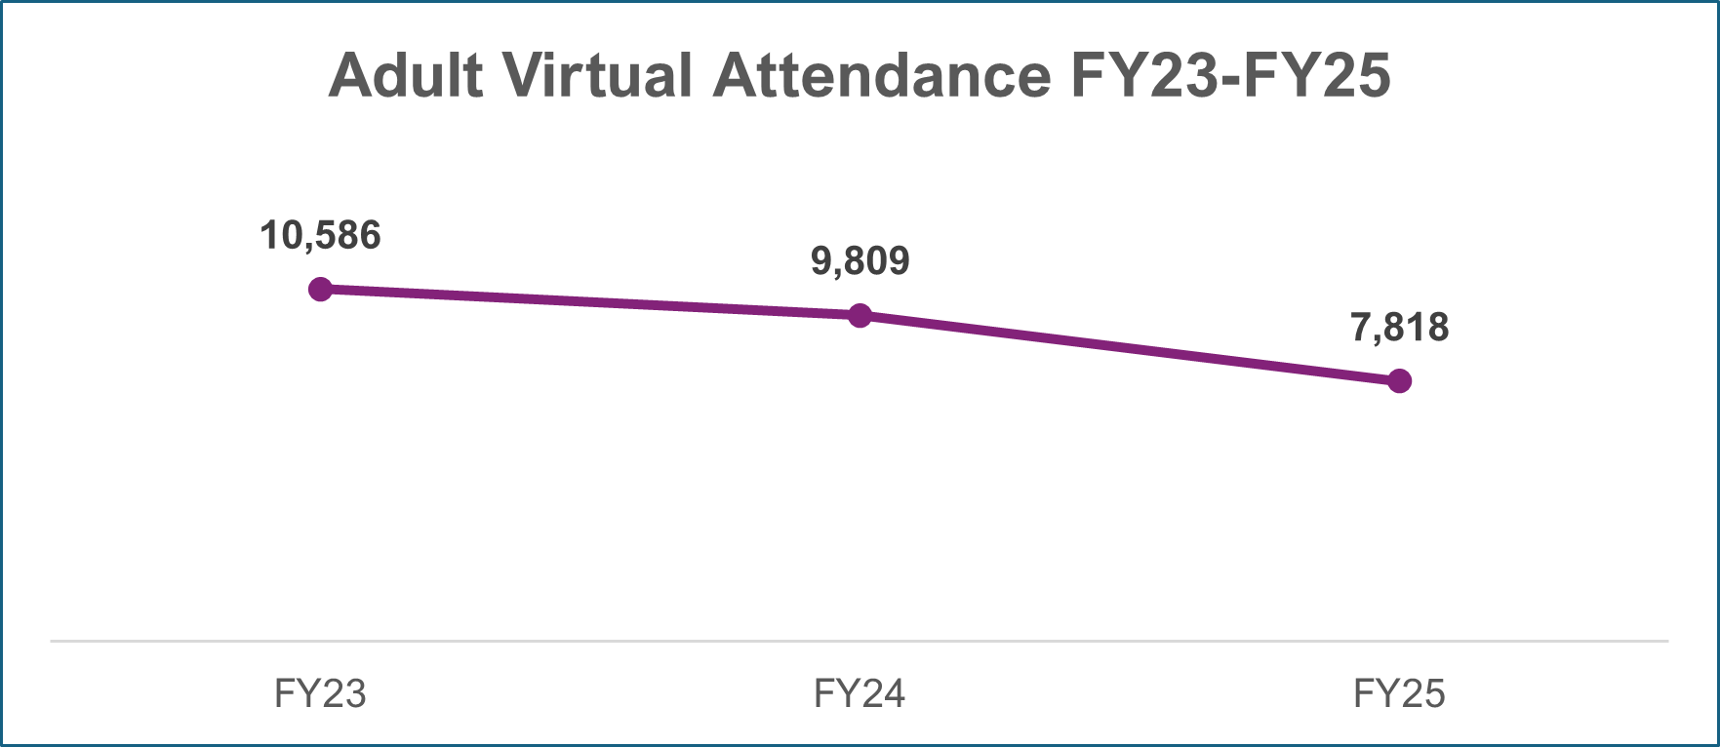
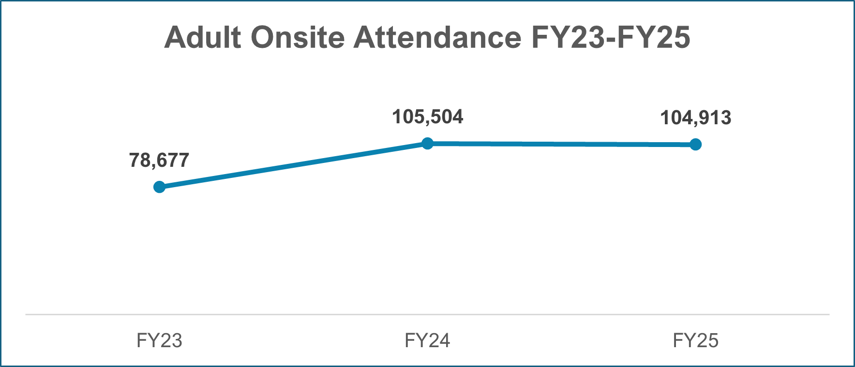
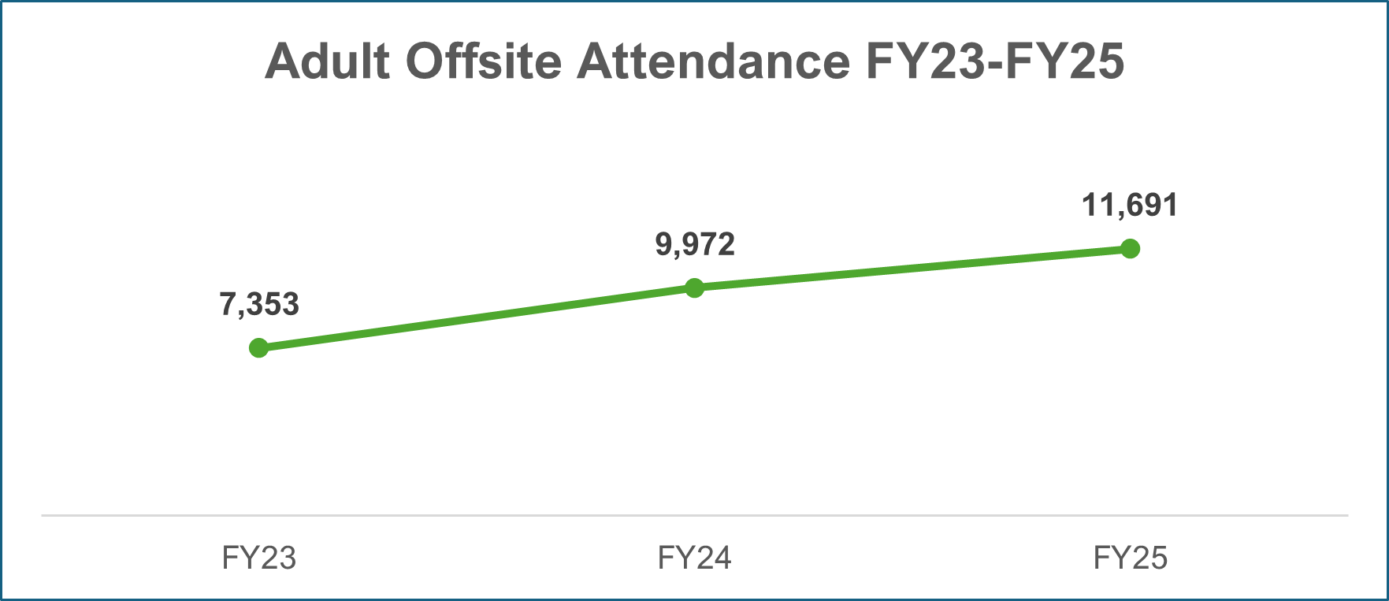
Adult Program Attendance
Adult audience second highest number of attendees for onsite programs in FY 2025.
Offsite program attendance continues to grow.
Virtual program attendance decreased 26% since FY23.

Slide 17
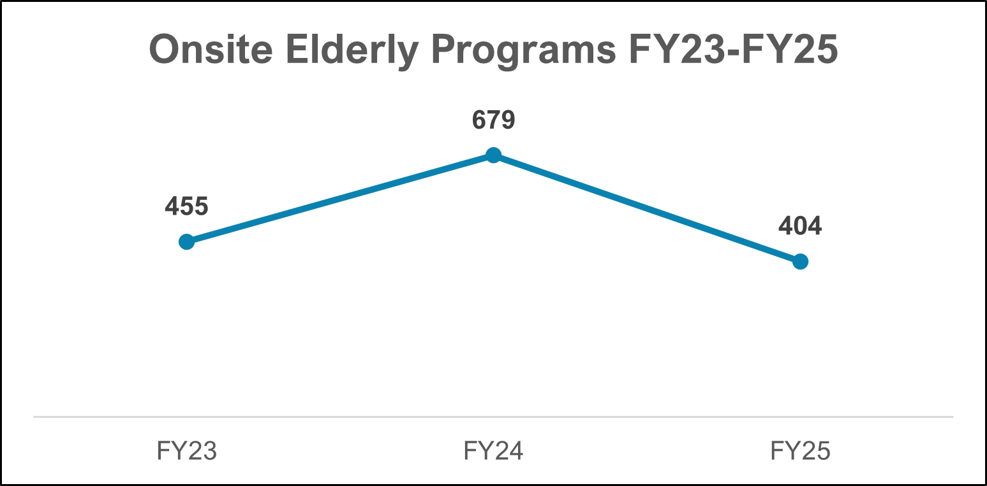
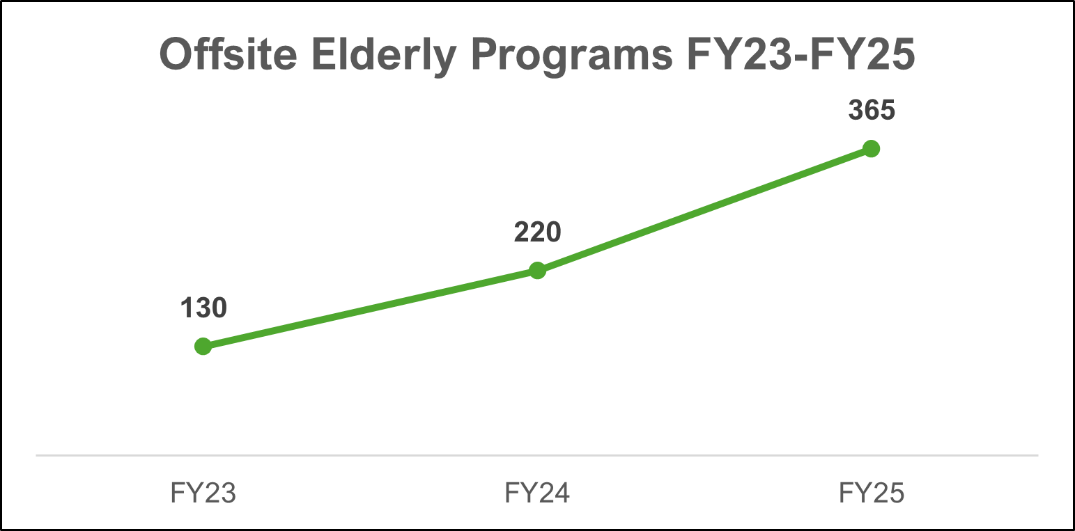
Elderly Program Sessions
Overall 11% increase from FY 2023 to FY 2025.
Offsite programs increased 65% between FY24 and FY25.

Slide 18
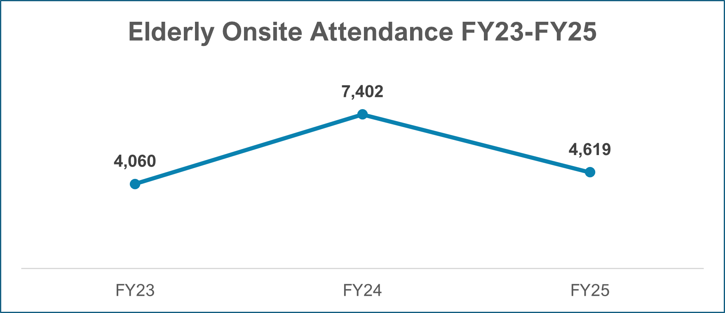
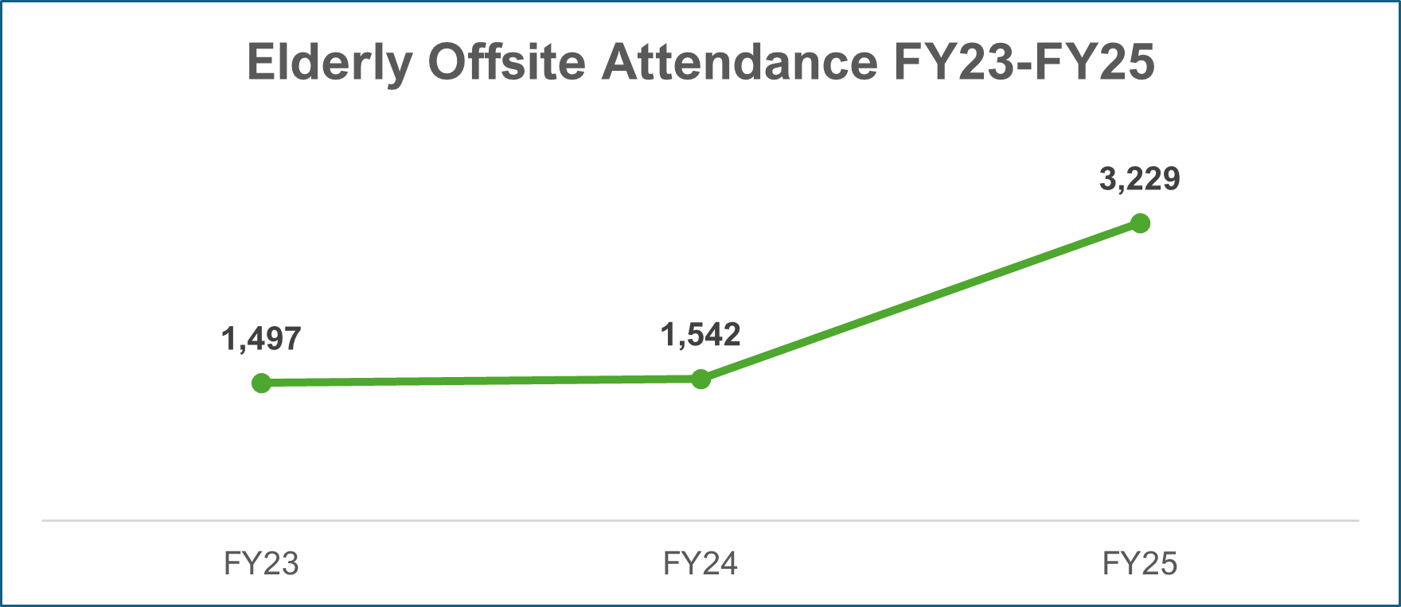
Elderly Program Attendance
Offsite attendance increased 109% from FY 2024 to FY 2025.

Slide 19
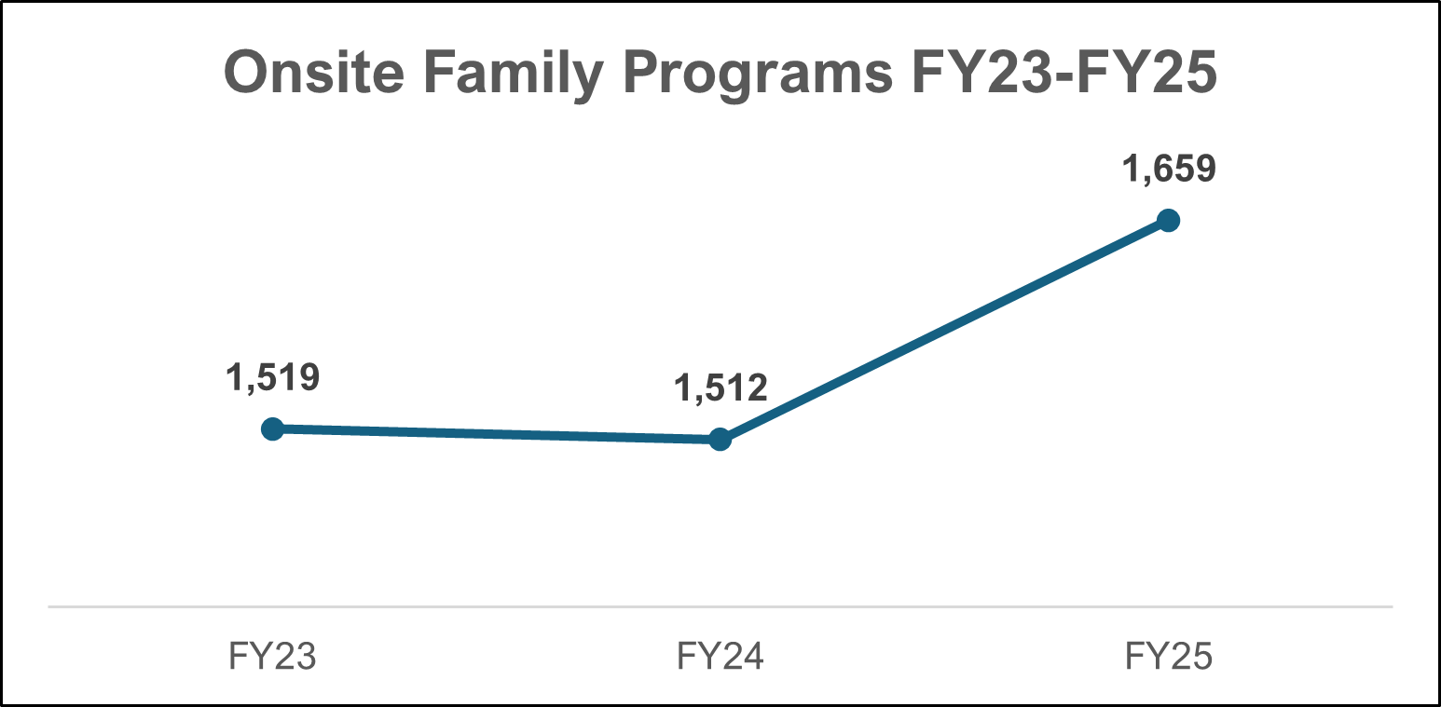
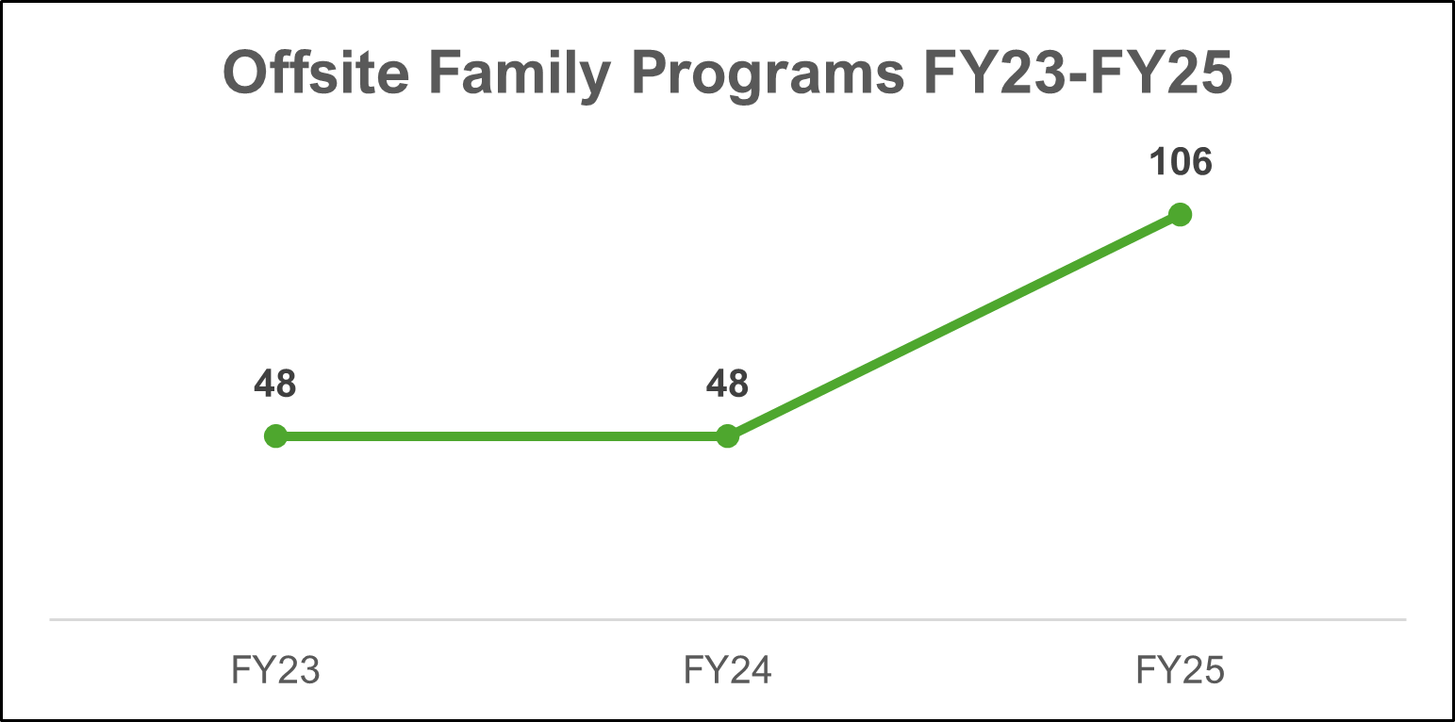
Family Program Sessions
Overall 13% increase from FY 2023 to FY 2025.
9% increase in onsite programs FY24 and FY25.
120% increase in offsite programs between FY24 and FY25.
Some libraries are now reporting Preschool story times as Family programs, which may have impacted trend data.

Slide 20
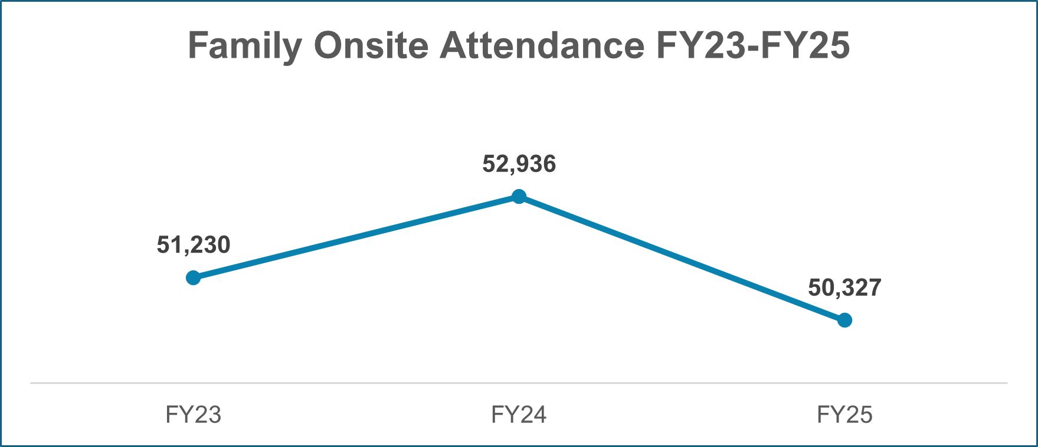
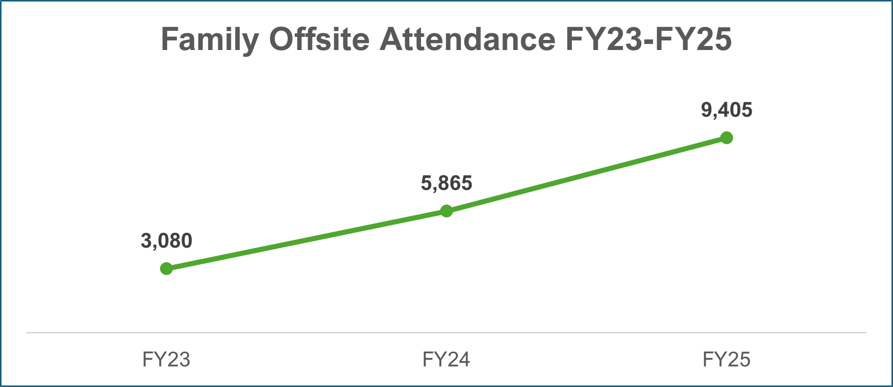
Family Program Attendance
Offsite attendance increased 60% between FY 2024 and FY 2025.
Onsite attendance decreased 4% despite increase in number of onsite programs offered.

Slide 21
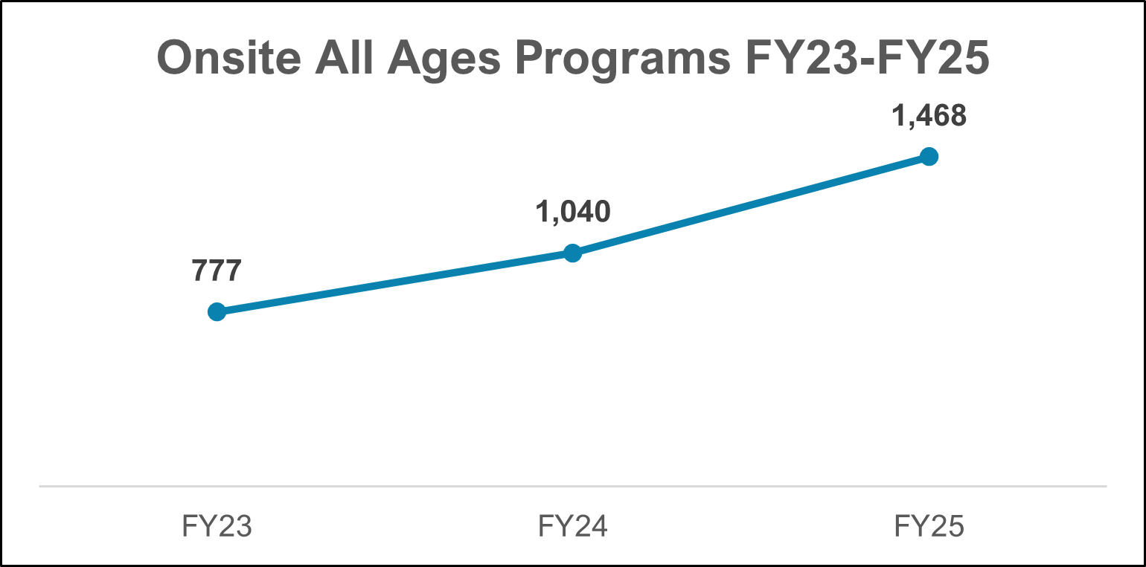
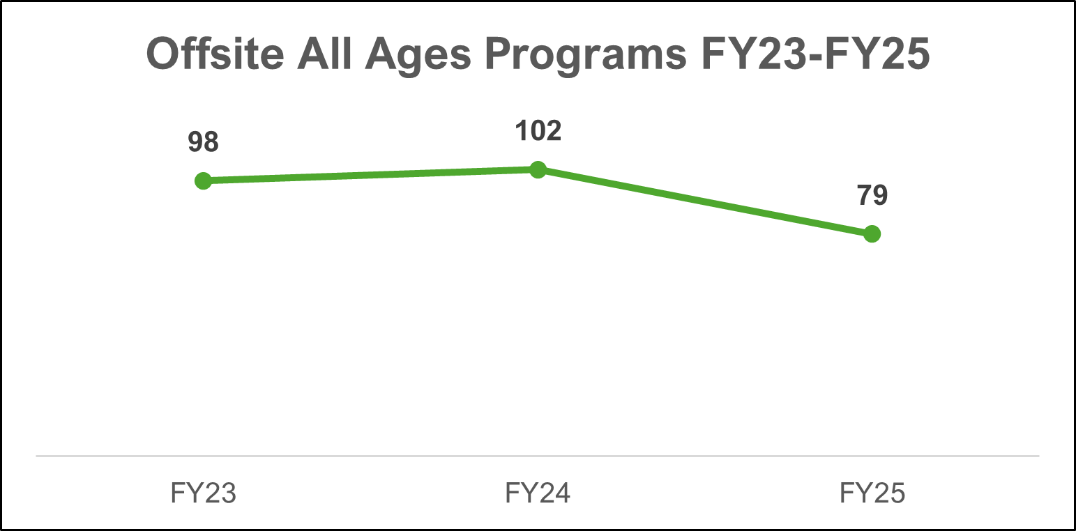
All Ages Program Sessions
Overall 63% increase from FY 2023 to FY 2025.
Onsite programs increased 41% between FY24 and FY25.

Slide 22
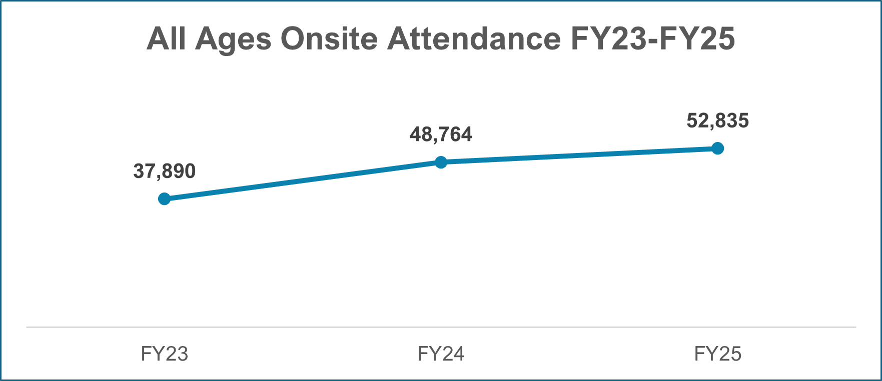
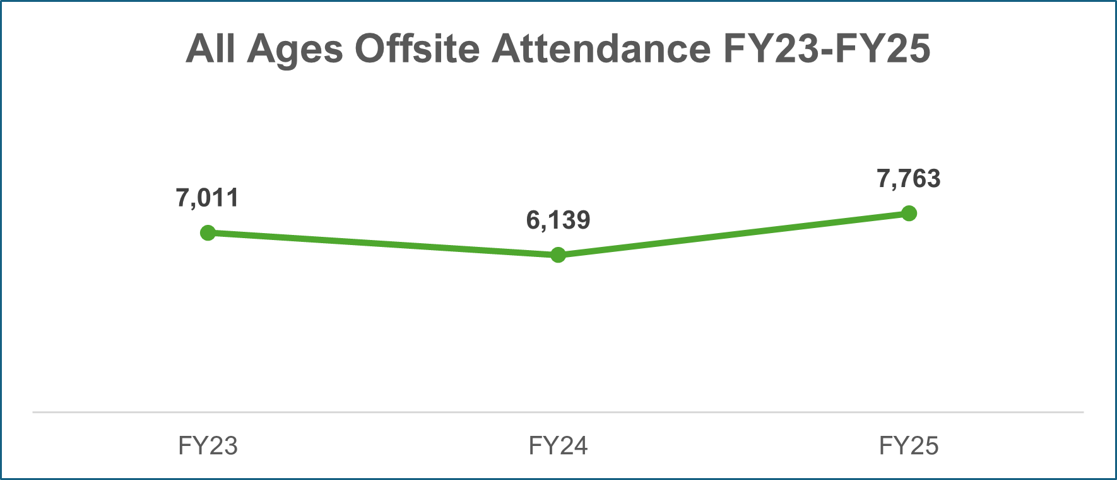
All Ages Program Attendance
Overall 33% increase in attendance between FY 2024 and FY 2025.
All Ages onsite attendance has steadily increased an average of 7,500 attendees each year from FY 2023 to FY 2025.
Offsite attendance increased 26% from FY 2024 to FY 2025, despite 22% decrease in number of offsite programs offered.

Slide 23
Other Programming Activities Trends

Slide 24
Recordings of Library-Created Content
89% decrease in number of recordings since FY 2021.
Number of Libraries Offering Recordings
Definition: Recorded videos or audio of program content that are posted online for downloading or on-demand viewing (rather than livestreaming).
FY 2021 was the first year this data was collected.
FY 2021 | FY 2022 | FY 2023 | FY 2024 | FY 2025
38 | 25 | 16 | 13 | 11
Number of Recordings
FY 2021 | FY 2022 | FY 2023 | FY 2024 | FY 2025
3,290 | 927 | 545 | 500 | 352

Slide 25
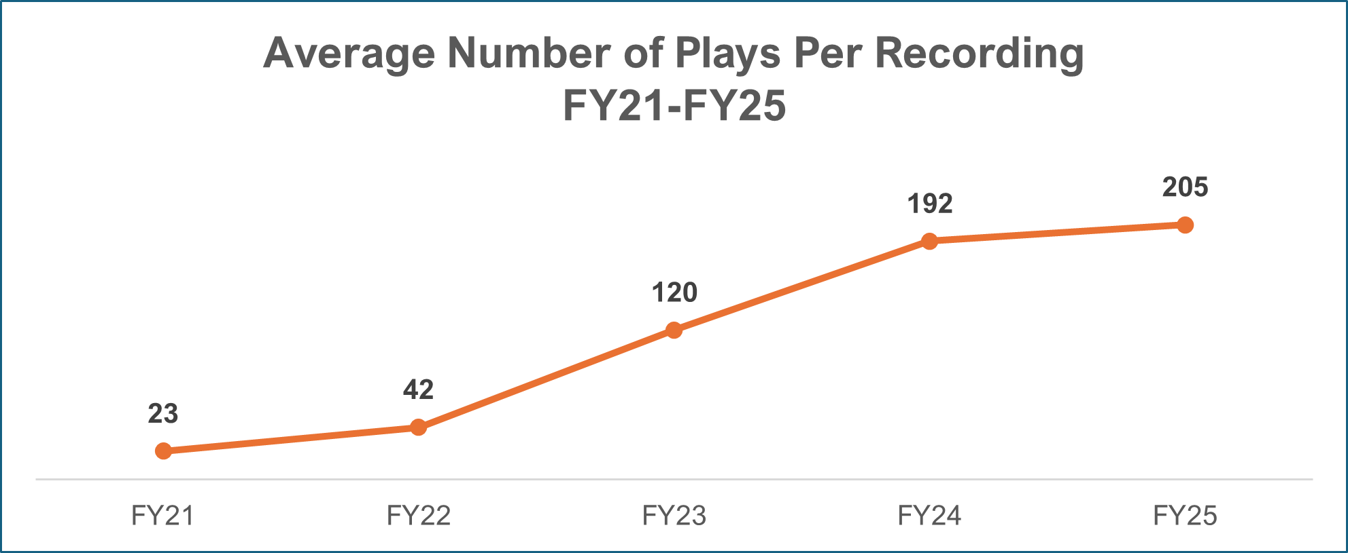
Total Plays of Asynchronous Recordings
Plays per recording has increased, even as number of recordings has decreased.
Number of plays has fluctuated dramatically.
Total Plays of Asynchronous Recordings within 30 Days
FY 2021 | FY 2022 | FY 2023 | FY 2024 | FY 2025
74,566 | 38,796 | 65,484 | 95,841 | 72,175

Slide 26
Self-Directed Activities
Different libraries go through years where no self-directed activities are offered.
Definition: A planned, independent activity available for a definite time period which introduces individuals participating to any of the broad range of library services or activities which directly provide information to participants. … Activities differ from programs in that activities are unstructured and depend on the participation of the individual to create the experience independently, rather than a structured program offered to a group at a set time.
FY 2021 was the first year this data was collected.
Number of Libraries Offering Self-Directed Activities
FY 2021 | FY 2022 | FY 2023 | FY 2024 | FY 2025
39 | 45 | 44 | 45 | 45
Total Number of Self-Directed Activities
FY 2021 | FY 2022 | FY 2023 | FY 2024 | FY 2025
2,691 | 3,052 | 3,038 | 2,339 | 2,348

Slide 27
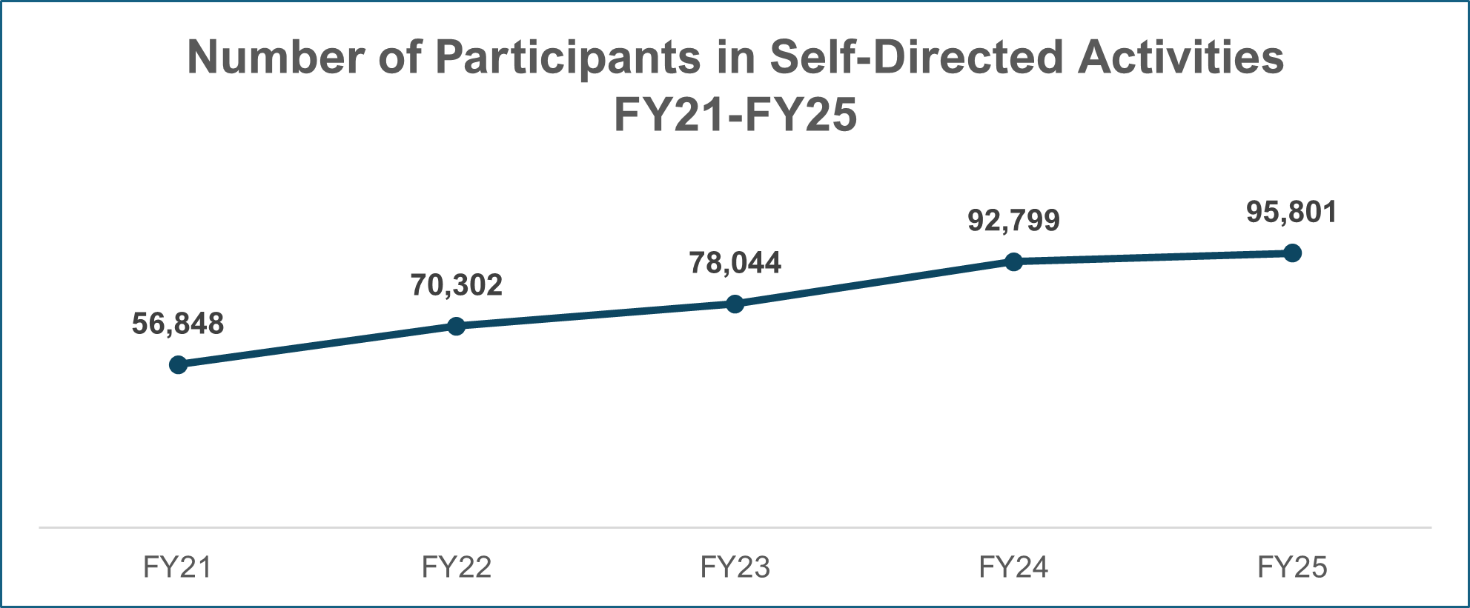
Total Participants in Self-Directed Activities
While the number of offered activities fluctuates, the number of participants continues to climb.
Total Number of Self-Directed Activities
FY 2021 | FY 2022 | FY 2023 | FY 2024 | FY 2025
2,691 | 3,052 | 3,038 | 2,339 | 2,348

