Slide 1
2020 Summer Learning Grants
Summer Learning Project Planning
November 7, 2019

Slide 2
About the Grant
Address summer learning loss
Meet the needs of low-income or underserved youth
Target youth ages 5-18
Relate to summer learning beyond tracking reading
Educators (learning opportunities) may be hired; performers (entertainment) may not be hired
Grant funds may not be used for:
Food
Prizes/incentives

Slide 3
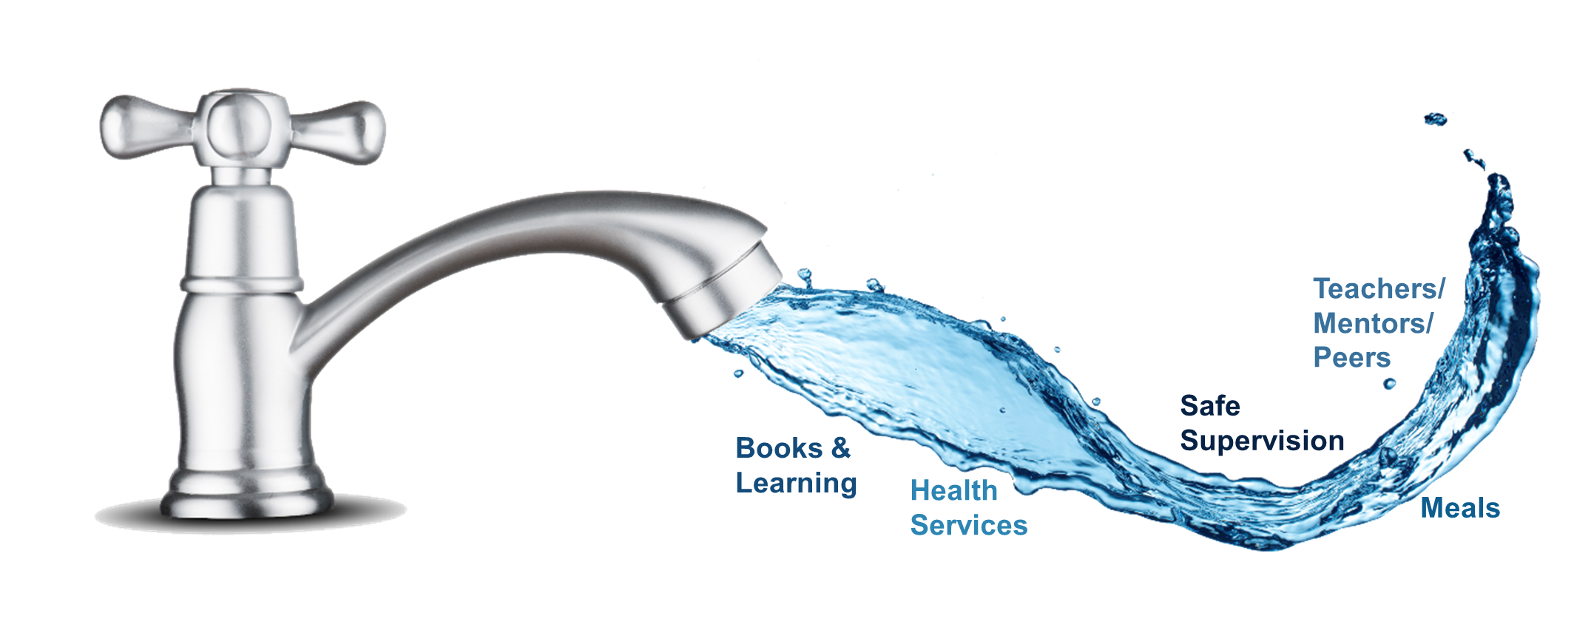
Why Summer Matters
During the school year resources are turned ON.
National Summer Learning Association

Slide 4
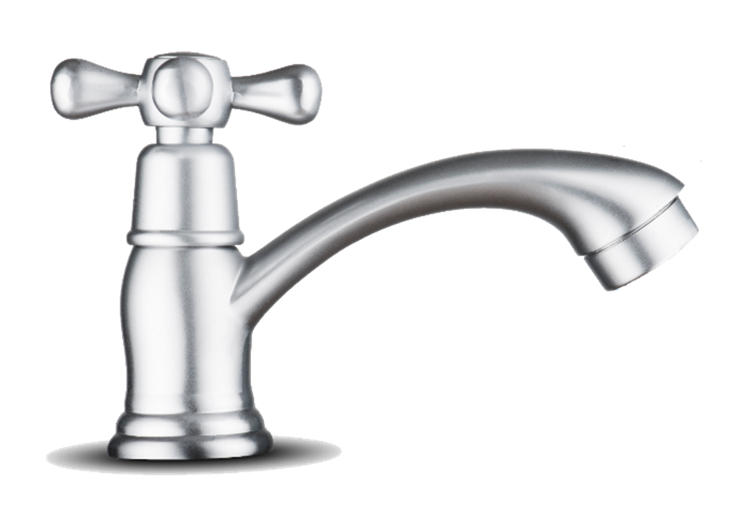
Why Summer Matters
During the summer resources are turned OFF for low-income youth.
National Summer Learning Association

Slide 5
Community Needs
What resources do you see as “turned off” in your community during the summer?
How do you know?

Slide 6
Needs & Goals
The community needs x because:
The library is implementing the project because:

Slide 7
Design Activity
Using the sticky notes, write down as many project ideas that come to mind
One idea per sticky note
Sky is the limit!
When time is called, take turns sharing each idea with the group

Slide 8
Design Activity
After sharing all ideas with your group, select one project idea that stands out
Take a large piece of sticky paper and illustrate your idea
Infographic, comic, stick figures, icons, etc. – it’s all good!

Slide 9
Tips for Writing Your Proposal
Be sure to:
Clearly identify the age group and the challenge/need
Clearly outline the goal and purpose of the project
Clearly define how the target audience will benefit
Address inclusion, i.e. underserved youth, diverse populations
Define activities and methods for accomplishing the project’s purpose
Describe resources required, i.e. materials, services
Describe which aspects of the project will be evaluated and how you will evaluate them
Identify the anticipated outputs and outcomes
Include a complete and reasonable budget

