Slide 1
2020 Summer Learning Grants Connected Learning Project Planning
November 20, 2019

Slide 2
About the Grant
Opportunity to put connected learning framework into practice
Must address the 6 principles of connected learning
Target tweens and teens (ages 11-18)
Consider how this project provides equity for underserved youth
Educators (learning opportunities) may be hired; performers (entertainment) may not be hired
Grant funds may not be used for:
Food
Prizes/incentives

Slide 3
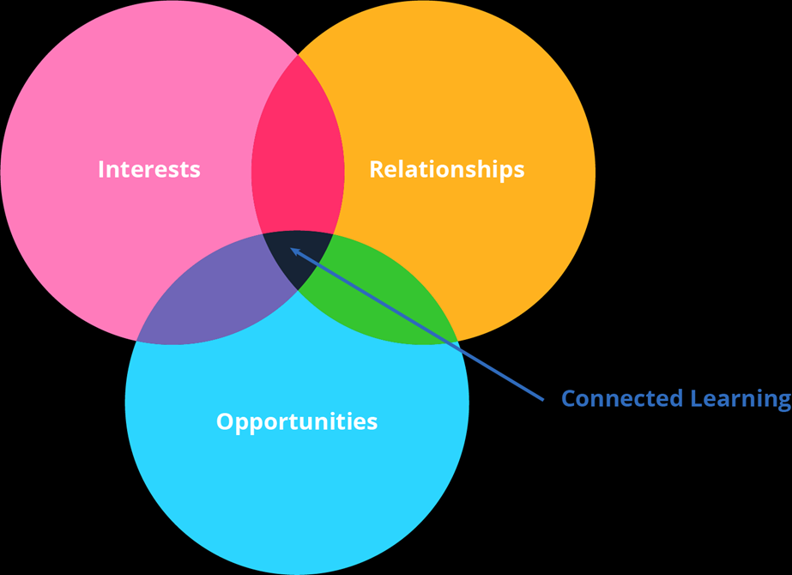
Remind me, what is Connected Learning?
CL knits together 3 elements
Interests
Production-Centered
Relationships
Opportunities
Shared Purpose
Openly Networked
3 core properties of a CL experience

Slide 4
Why Connected Learning?
https://youtu.be/mFBqOgCssZI

Slide 5
What does Connected Learning look like for youth?
Interests
Here is Alex. They are an avid pop culture fan and love professional wrestling.
Relationships
Alex discovers Wrestling Clique, an online community of people who share their passion and interests in pro-wrestling. They decide to start writing fan fiction about pro wrestlers using Wattpad, a free online publishing tool. They start building a fan base and their confidence grows.
Opportunities
Alex decides they are interested in becoming a professional writer and applies to a magnet high school to study journalism.

Slide 6
Connected Learning in RI Libraries
Beat Making at the Tiverton Public Library
Used Teenage Engineering Pocket Operators
Discover West Warwick at the West Warwick Public Library
5-week career exploration project in conjunction with the Comprehensive Community Action Program
Participants created a multimedia project highlighting the arts, culture and history of West Warwick
https://tinyurl.com/yxa28mrw
Library Media Production Lab at East Greenwich High School
Converted a school library office into a multimedia production studio
Students may use the studio independently or as part of a class project
https://tinyurl.com/y6rby5a9
Teen Squad at the Providence Public Library
Driven by youth interests while focusing on work readiness and 21st-century skills development
Four programs: data analytics, hospitality/tourism/marketing, coding, and culinary arts
https://www.provlib.org/teen-squad-overview/
Facilitated by a staff member with sound engineering background

Slide 7
Why the library? (Aka, your project purpose)
Informal Learning
Youth learn through interactions with their peers, community, adults and technology
Equity
Not all youth have access to tools and technology to compete in the workforce or even in school
Connections
Community organizations, businesses, and individuals have knowledge, skills, and resources to build youth workforce development
You’re already doing it!
Libraries already leverage relationships (among peers and adult mentors) and youth interest to inform the design and implementation of youth programs and services
HOMAGO (Hanging Out, Messing Around, and Geeking Out), coined by researcher Mimi Ito
Out-of-school enrichment activities aren’t accessible to all

Slide 8
Design Activity
Using the sticky notes, write down as many project ideas that come to mind
One idea per sticky noted
Sky is the limit!
When time is called, take turns sharing each idea with the group

Slide 9
Design Activity
After sharing all ideas with your group, select one project idea that stands out
Take a large piece of sticky paper and illustrate your idea
Infographic, comic, stick figures, icons, etc. – it’s all good!

Slide 10
Tips for Writing Your Proposal
Be sure to:
Clearly identify the age group and the challenge/need
Clearly outline the goal and purpose of the project
Clearly define how the target audience will benefit
Address inclusion, i.e. underserved youth, diverse populations
Define activities and methods for accomplishing the project’s purpose
Describe resources required, i.e. materials, services
Describe which aspects of the project will be evaluated and how you will evaluate them
Identify the anticipated outputs and outcomes
Include a complete and reasonable budget

Slide 11
Resources
YALSA Transforming Teen Services: A Train the Trainer Approach (T3)
http://www.ala.org/yalsa/train-trainer-project
OLIS T3 LibGuide
https://olis-ri.libguides.com/yart/T3
West Warwick Public Library Discover West Warwick
https://tinyurl.com/yxa28mrw
East Greenwich High School Library Media Production Lab LibGuide
https://tinyurl.com/y6rby5a9
Providence Public Library Teen Squad
https://www.provlib.org/teen-squad-overview/
Connected Learning Alliance
https://clalliance.org/
ConnectedLib
https://connectedlib.github.io/
Connected Learning Research Network
https://clrn.dmlhub.net/index.html
YOUmedia Learning Labs Network
https://youmedia.org/

