Slide 1
Summer Reading 2019 Wrap-up and Grant Workshop
October 7, 2019
Cranston Public Library

Slide 2
Agenda
1pm – 2:15pm Table Talk Discussions
2:15pm – 2:45pm Discussion Share Out
2:45pm – 3:30pm 2019 Summer Learning Grant Projects
3:30pm – 3:50pm 2020 Learning Grants: Introduction and Process

Slide 3
Table Talk Discussions
Pick a table with a topic that is of interest to you. Each table has guiding questions for discussion – use them or toss them out! After 20 minutes you will be invited to switch tables. You may stay at your table or move on to explore another topic. A table switch will be announced three times before coming back together as a large group to share key takeaways.
Topics:
Best Practices
Building and Sustaining Partnerships
Expanded Learning Opportunities
Marketing and Promotion
Summer Burnout
Open Topic

Slide 4
Share Out
What common threads came up in your discussions?
What idea(s) can you implement at or scale for your library?
What can we learn from 2019 to plan for 2020?

Slide 5
2019 Summer Learning Grants
Davisville Free Library: Think Tank Collaboration
Greenville Public Library: Summer Learning Lab
Tiverton Public Library: Reach for the Stars
West Warwick Public Library: Discover West Warwick
Notes:
OLIS awarded 4 public libraries Learning Grants through the 2019 LORI Grant Program. The LORI Learning Grant Program provides opportunities for Rhode Island libraries to apply for smaller LORI Grants to work on innovative, forward-looking projects for youth learning that can be replicated in other libraries. LORI Learning Grants must meet the priorities of the 2018-2022 OLIS Five Year State Plan for the expenditure of LSTA funds. Specifically, grants must support learning opportunities in libraries for youth ages 5-18 related to Summer Learning or Connected Learning.
LORI Grants are supported through the federal Institute of Museum and Library Services (IMLS) and funded through the IMLS Grants to States program under the Library Services and Technology Act.

Slide 6
Greenville Public Library: Summer Learning Lab
The goal:
Diminish summer learning loss for children in grades 2-8 by engaging teens in grades 8-12 as tutors
The project:
Caregivers apply to enroll children as students and determine the subject areas for which children need tutoring
Young adults apply and are interviewed before being offered positions as tutors
Tutors will receive required volunteer hours for community service programs
iPads and apps as well as other tools will be purchased to facilitate tutoring and learning

Slide 7
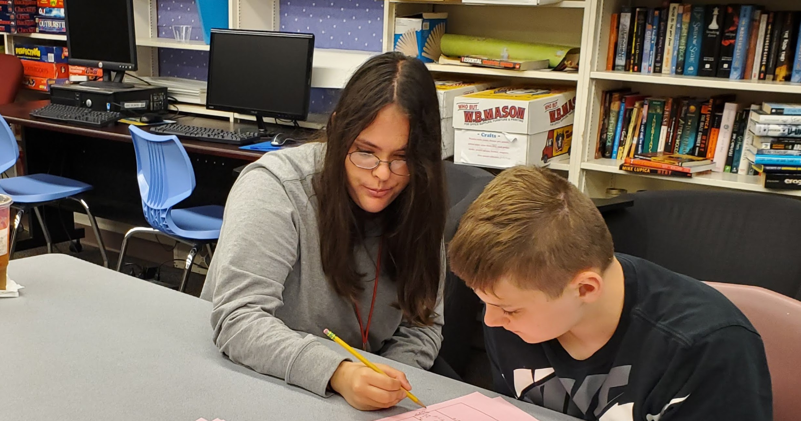
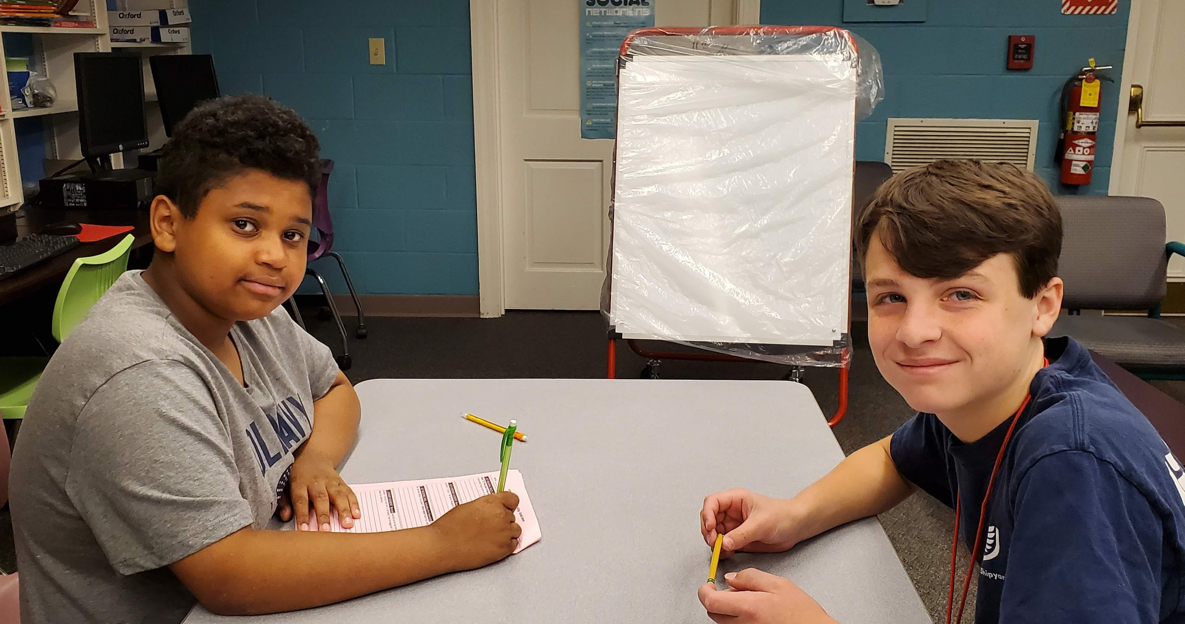
Greenville Public Library: Summer Learning Lab
Project Need
Why a Summer Learning Lab?
How did it address Summer Learning
Project Description
Design
Activities and timeline
Outcomes
Questions?

Slide 8
West Warwick Public Library: Discover West Warwick
The goal:
Teach teens 21st-century skills as they explore career pathways and interests.
The project:
Youth ages 14-18 from West Warwick take part in a 5-week career exploration project in conjunction with the Comprehensive Community Action Program
Youth create a multimedia project highlighting the arts, culture and history of West Warwick

Slide 9
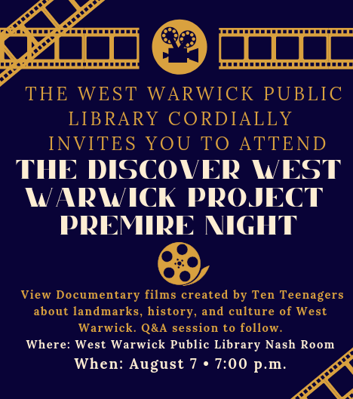
West Warwick Public Library: Discover West Warwick
Project Need
Why a career/multimedia centered project?
How did it address Summer Learning?
Project Description
Design
Partners
Activities and timeline
https://www.youtube.com/channel/UClDjPNoipDklDhANZyHaeGg?view_as=subscriber
Outcomes
Questions?
Notes:
Show video til the 8:18 mark. All videos are linked on the Learning Grant Tab of the SRP LibGuide at https://olis-ri.libguides.com/SRP/learninggrants

Slide 10
Davisville Free Library: Think Tank Collaboration
The goal:
Mitigate summer learning loss for 1st and 2nd graders enrolled in the Think Tank Program
The project:
Partner with the North Kingstown School Department’s Think Tank to bring 1st and 2nd grade children to the library weekly for educational programming, book selection, and participation in the summer reading program
Parents in nearby supportive housing are invited to join their children at the library and to join in the activities

Slide 11
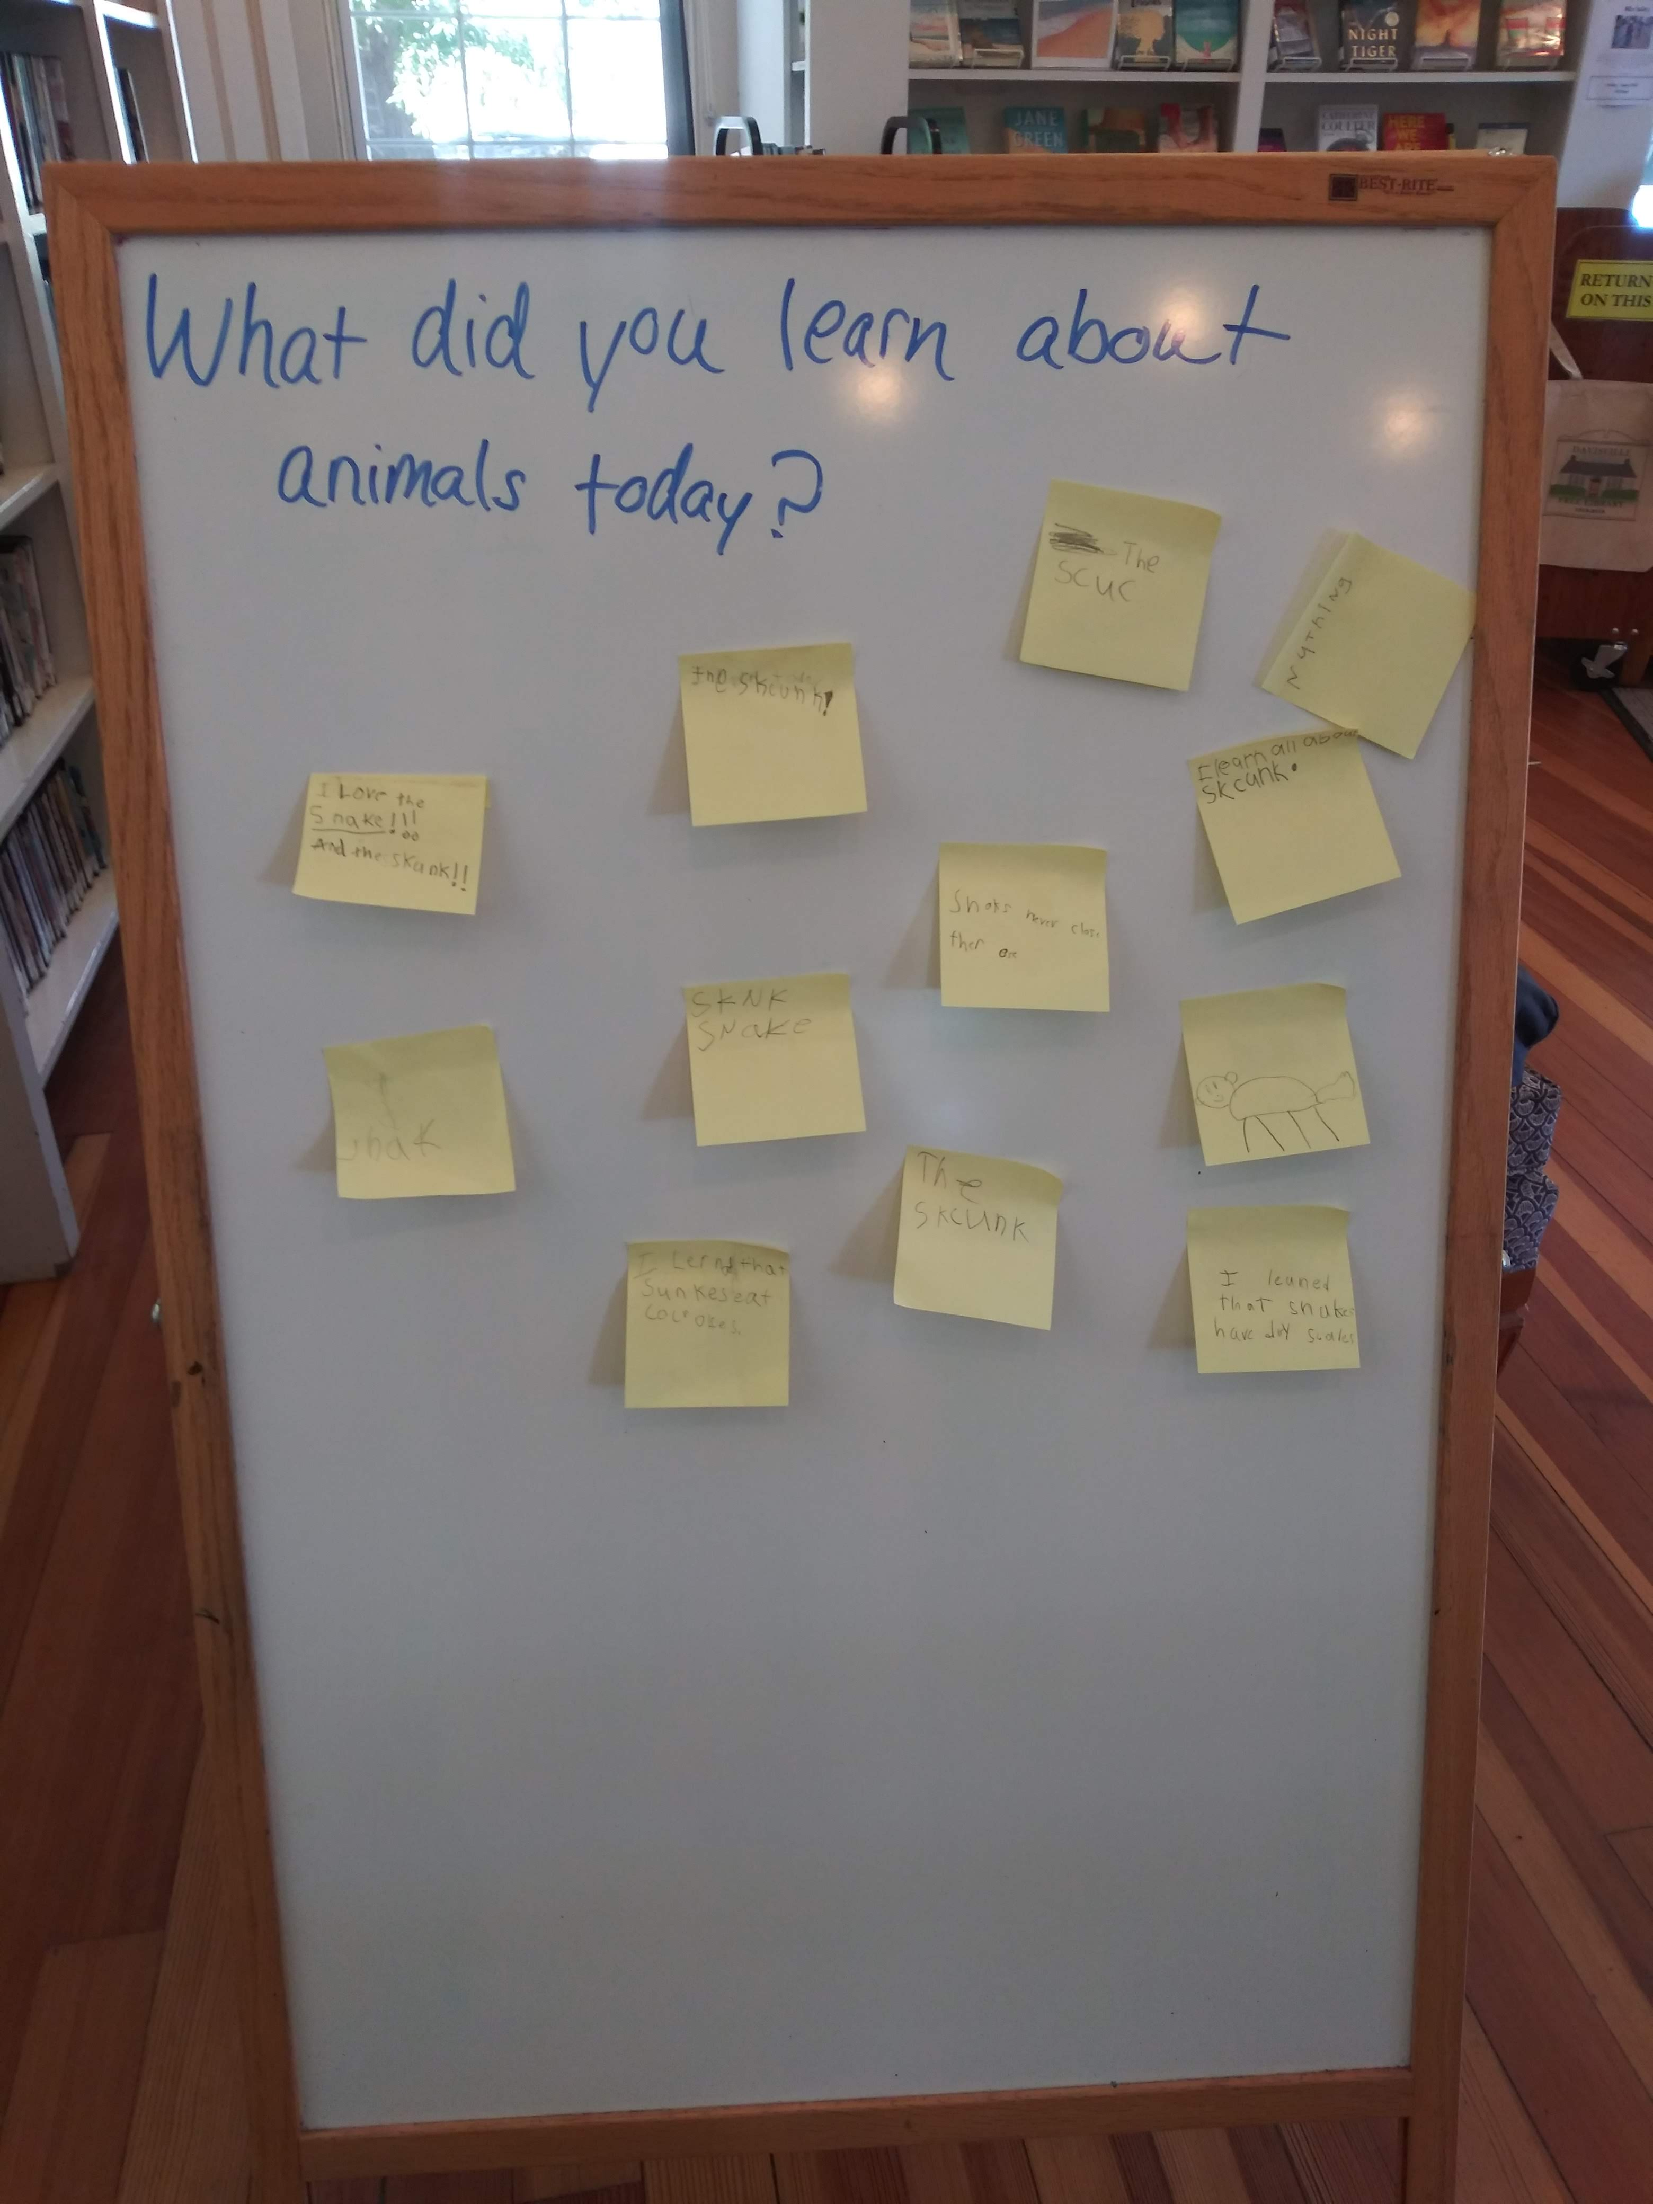
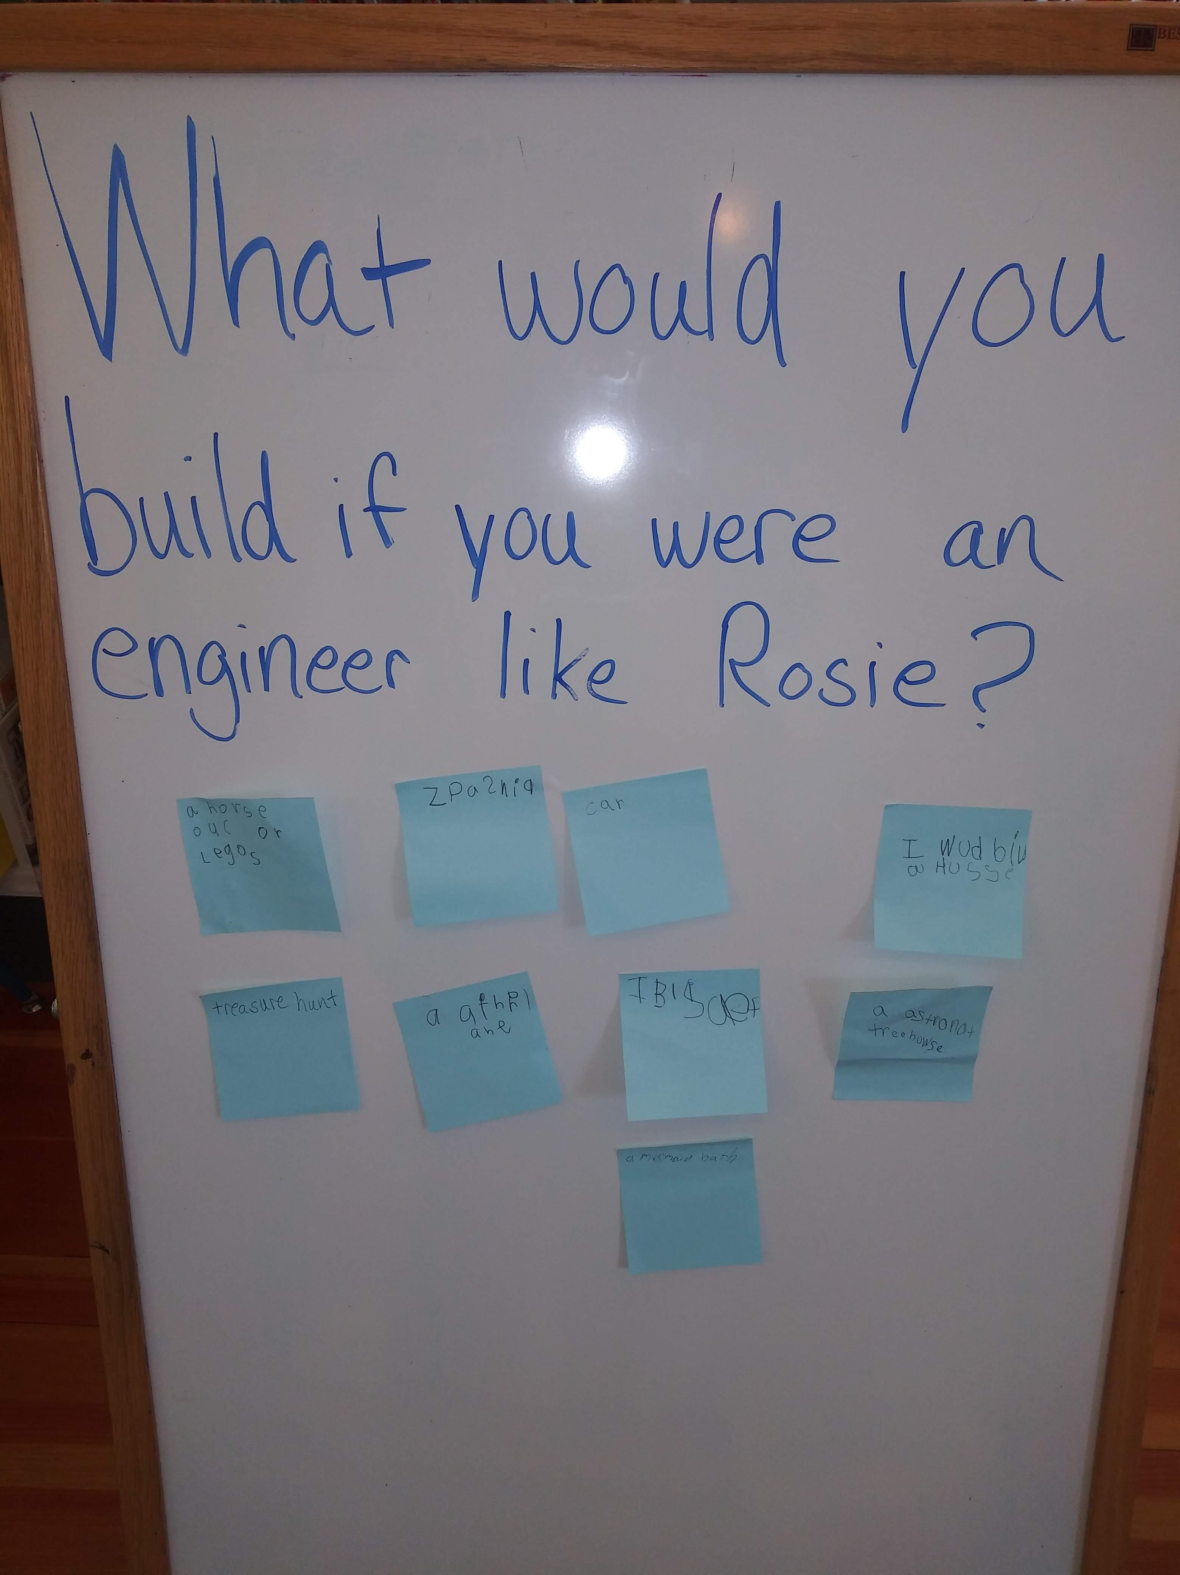
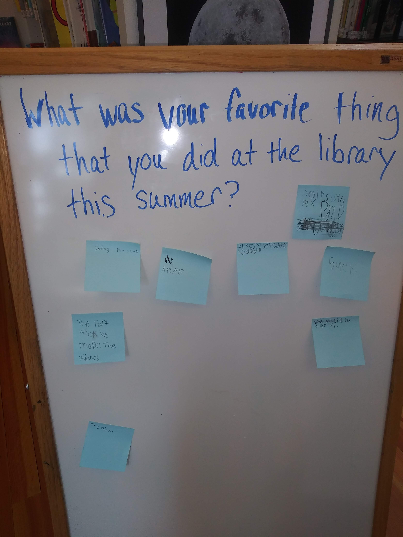
Davisville Free Library: Think Tank Collaboration
Project Need
Why a collaboration with Think Tank?
How did it address Summer Learning?
Project Description
Design
Partners
Activities and timeline
Outcomes
Questions?
Amanda Chapman, Library Director

Slide 12
Tiverton Public Library: Reach for the Stars
The goal:
Provide children ages 5 – 10 with Science Technology Engineering and Math (STEM) based enrichment opportunities on a family-friendly schedule
The project:
Provide educational and interactive displays
Space themed activities and materials to support A Universe of Stories
Circulate STEM-based kits

Slide 13
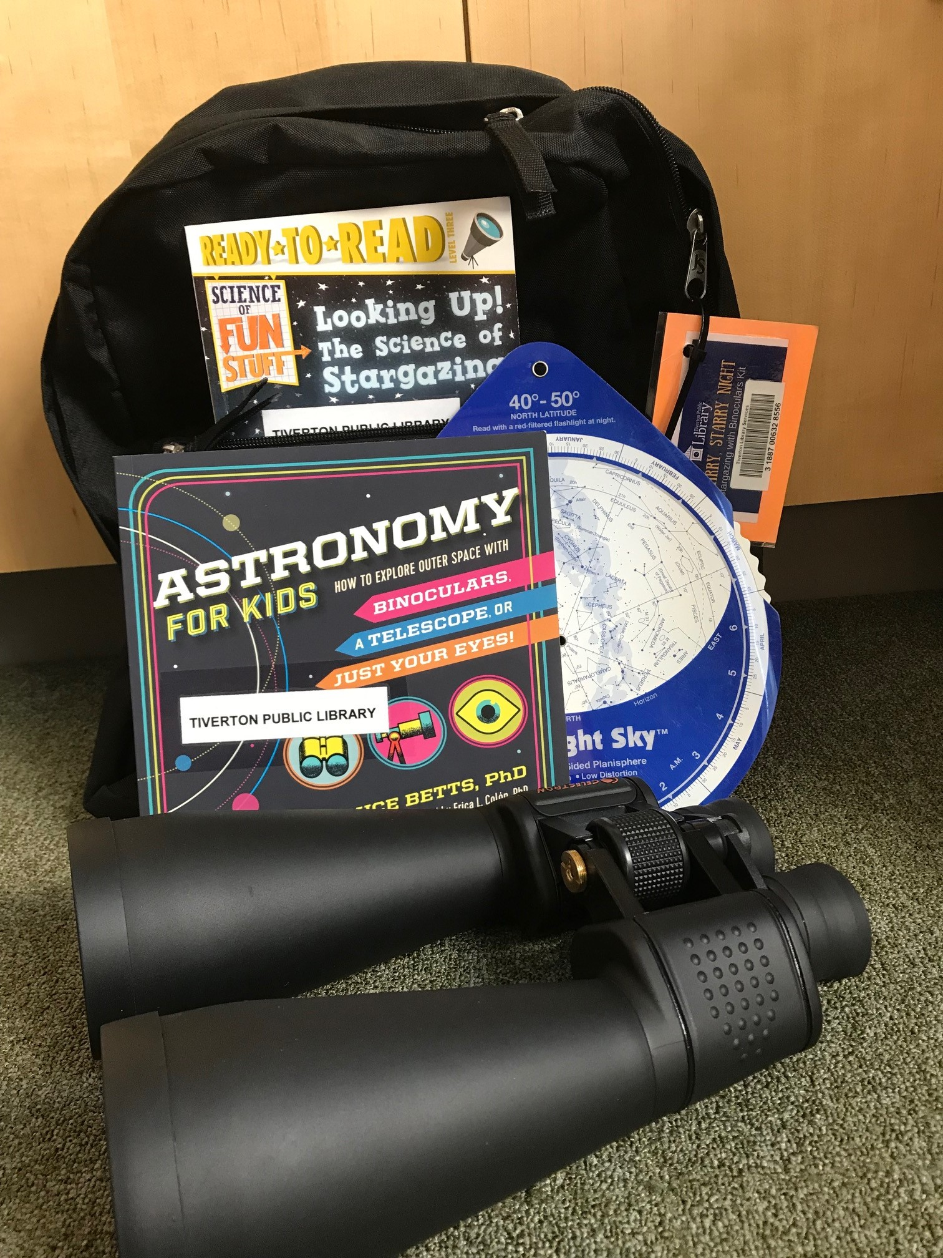
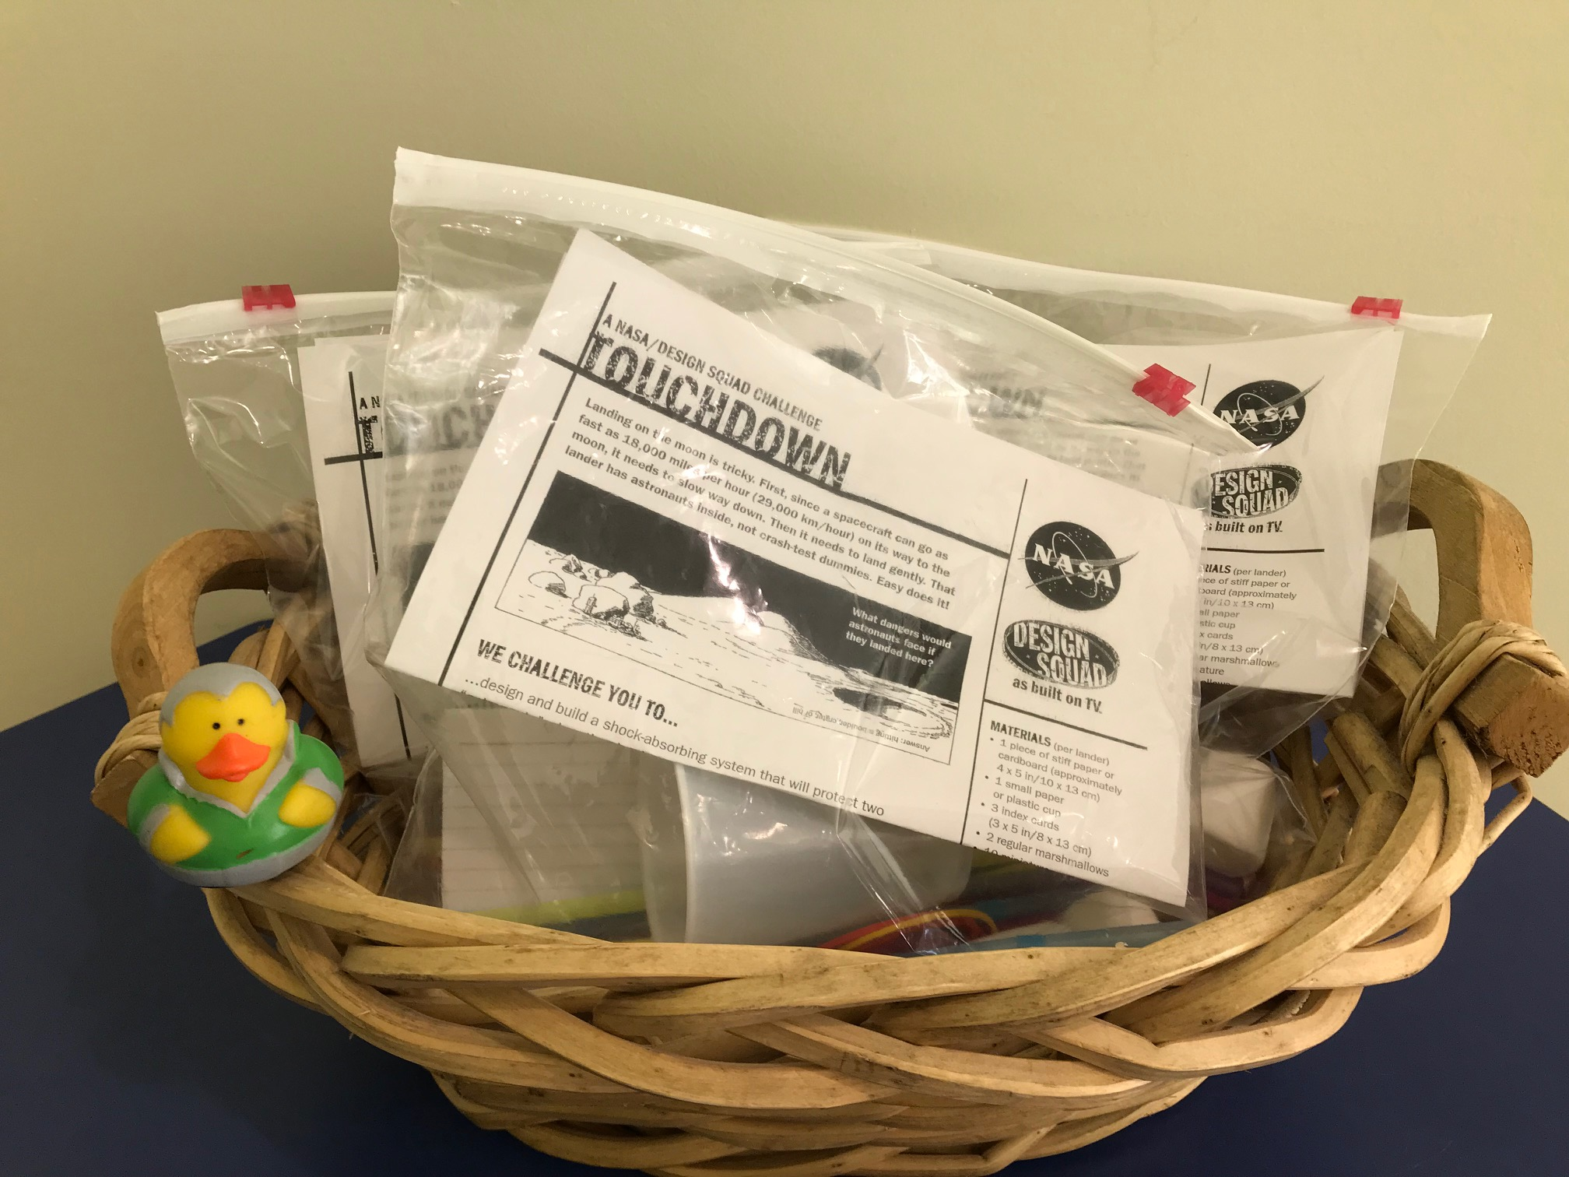
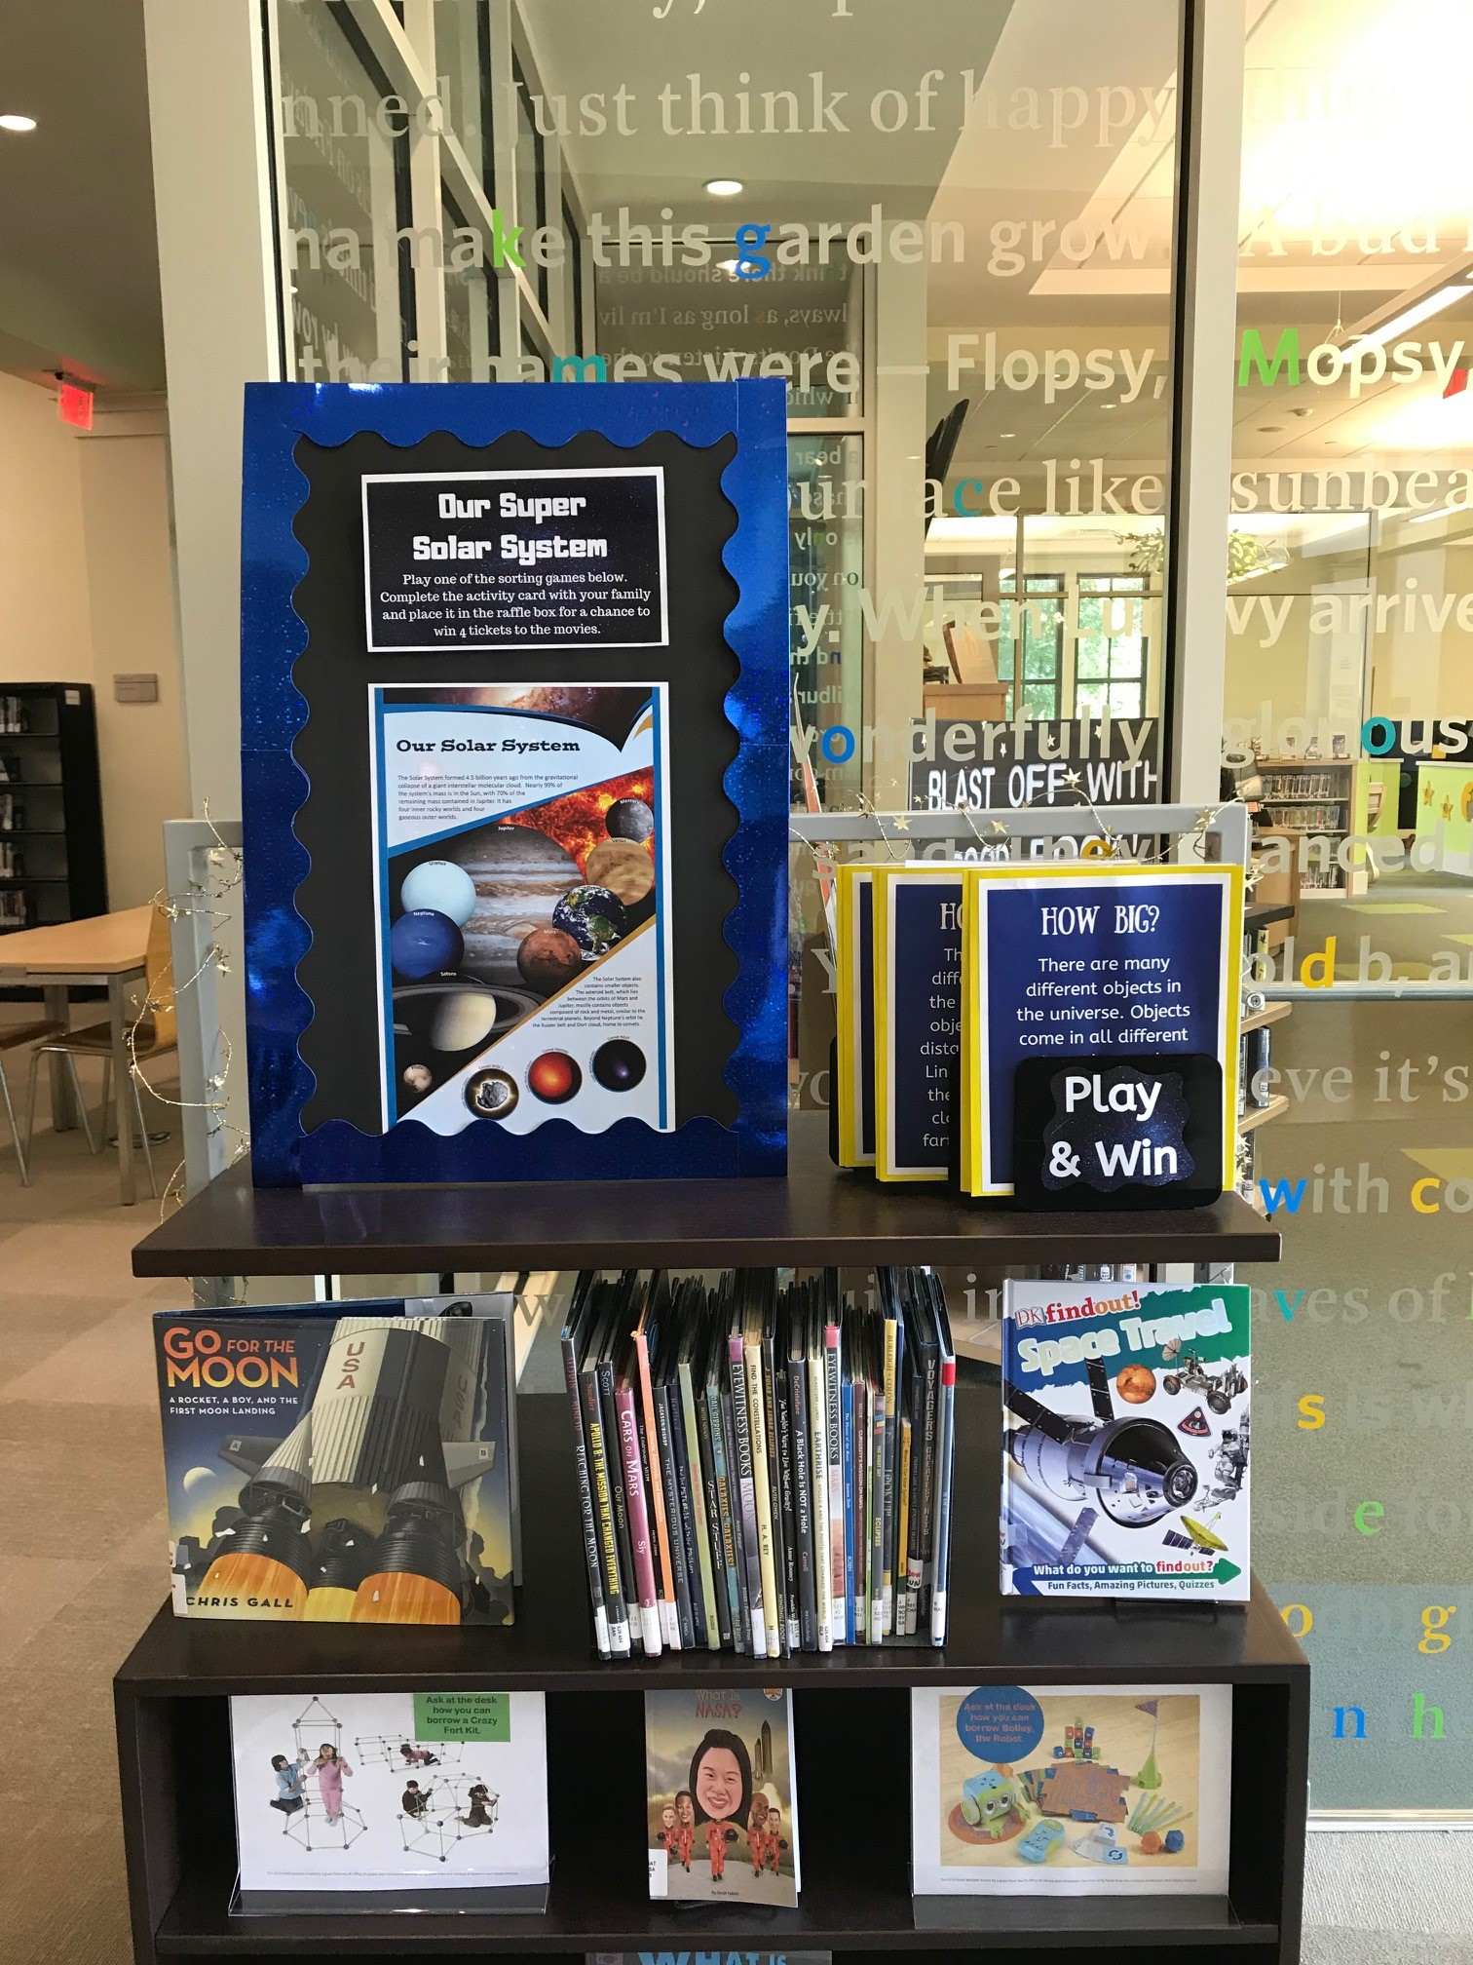
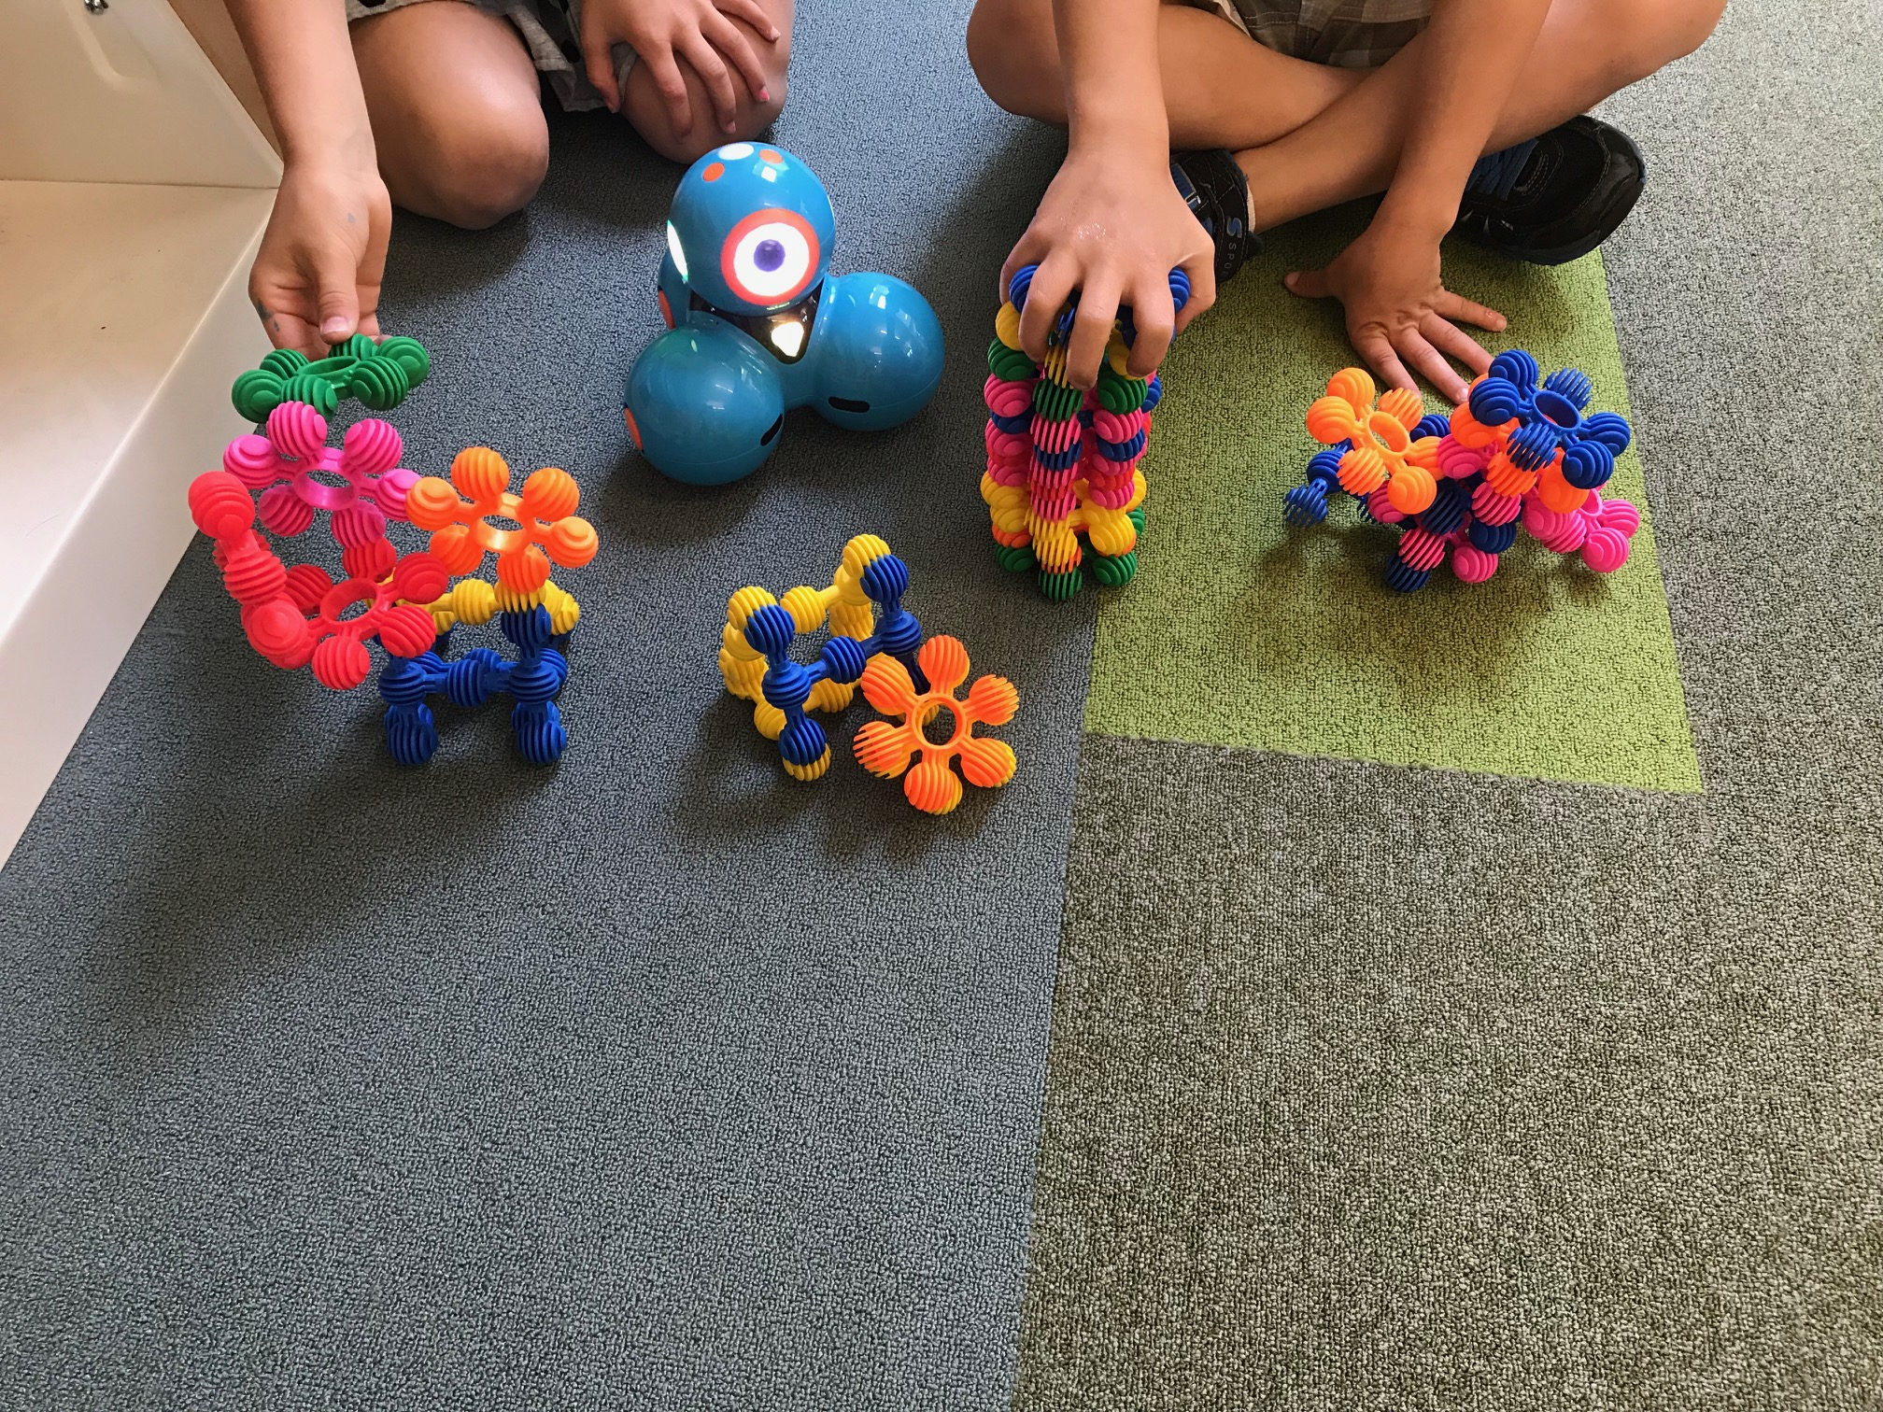
Tiverton Public Library: Reach for the Stars
Project Need
Why circulating kits and interactive displays?
How did it address Summer Learning?
Project Description
Design
Activities and timeline
Outcomes
Questions?
Meg Paquette, Children’s Librarian

Slide 14
Learning Grants 2020
Two types of grants available:
Summer Learning Grants
To increase impact on summer learning loss for youth ages 5-18
Projects should relate to summer learning beyond tracking reading accomplishments and address the disparities faced by low-income and underserved youth in the community
Connected Learning Grants
To put into practice key elements of the connected learning framework for services to tweens and teens as demonstrated in OLIS’ T3 trainings
Projects must address the six principles of connected learning: interests, relationships, opportunities, production-centered, shared purpose, and openly networked
Both are available in amounts up to $2,000

